Slide 1
Making the most out of social distancing: Live-streamed citizen science to the rescue!
Notes:
Logos URL to the scistarter resource for CSM

Slide 2
Tell us about yourself! Name, org, cit sci event or project (click and type!)

Slide 3
Ariel
Caroline
Xochitl
Science Friday
@Arieloquent
SciStarter
@CHNickerson
Science Friday
@msxgarcia

Slide 4
How are you feeling about livestreaming? Anything you want to make SURE we discuss?

Slide 5
It’s a great time to livestream.
No, seriously.

Slide 8
Why livestream?
Accessibility
Viewed, heard, and hosted anywhere there is internet
Recorded, slowed, translated, and captioned
Interactivity
Good livestreams feel like conversations
Participation from hosts, guests, regardless of geography
Great, affordable platforms (software). Yay.

Slide 9
Poll: What’s your current streaminess?
I’ve never seen a livestream before 🙈 🙉 🙊
I’ve only watched 👀 livestreams, but never participated.
I’ve participated in a livestream before 🙋🏻‍♀️ (chat, polls, emoji, claps, camera, discussion)
I’ve hosted a livestream before, fancy me! 🦚
I’ve done this loads of times, I’m trying to get better 🤸‍♀️
I’m actually a total boss at livestreaming stuff 🔥
Notes:
Both organizers and implementers - looking for content

Slide 10
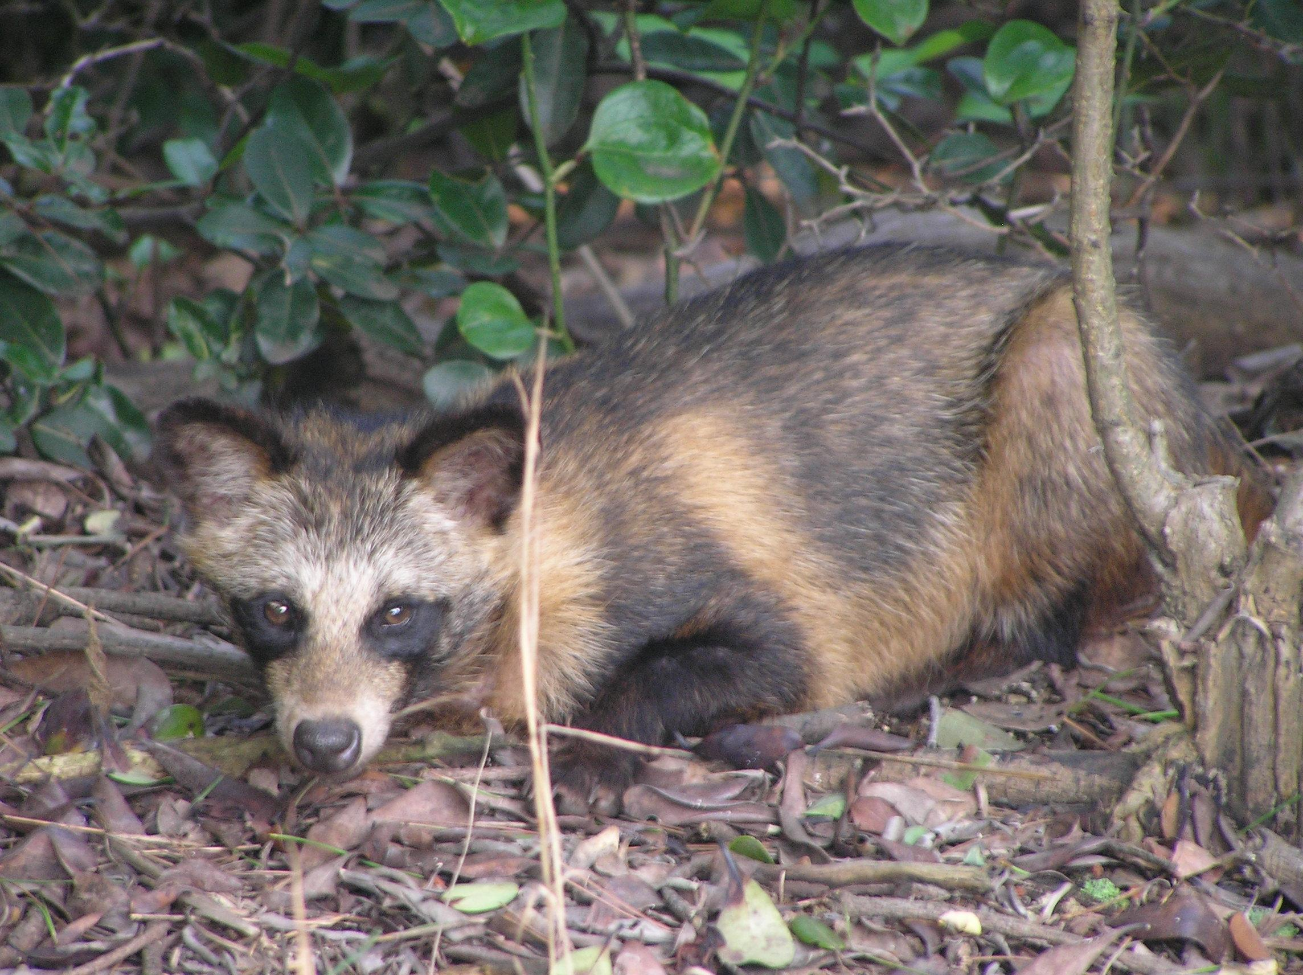
You may be feeling like a racoon dog Adorable, categorically confused, a bit shy... Prue Simmons / CC BY (https://creativecommons.org/licenses/by/2.0)

Slide 11
But you’re here, we’re stoked
Share
This is a learning and collaboration space. Fear not the chat.
It’s a weird time, and it’s harder than normal.
That’s ok, we’re all doing our best. Be a cheerleader and virtual hugger.
We’re gonna learn
In the next month, we’re all going to learn a lot about livestreaming. That’s rad!
Let’s make this fun.

Slide 12
SciStarter
Connecting citizen scientists to the projects that need their help
3,000+ projects and events
Girl Scouts Journey, School Programs, Life-Long Learning Programs, Tools Database, Corporate Volunteer Programs
Citizen Science Month: This April!

Slide 13
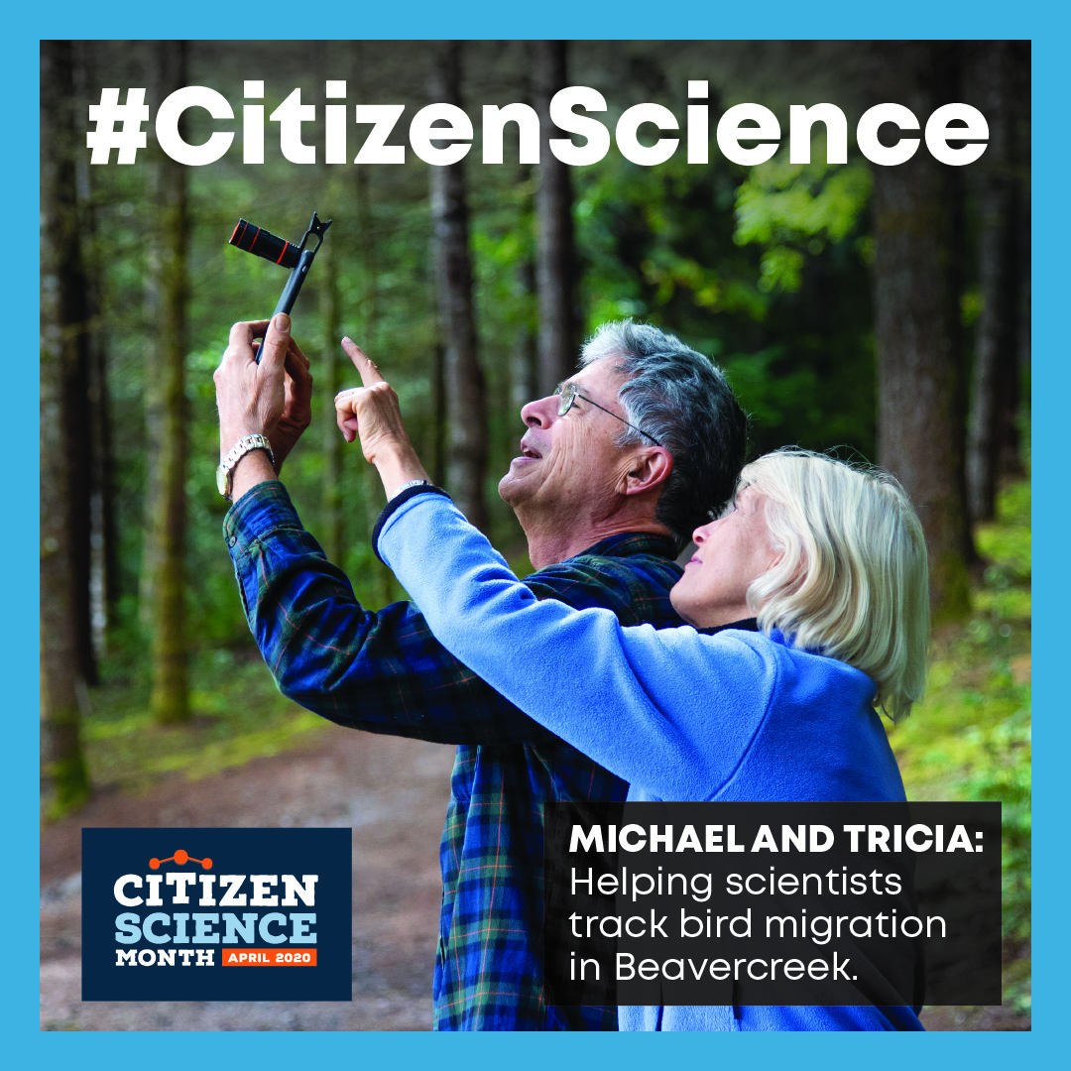
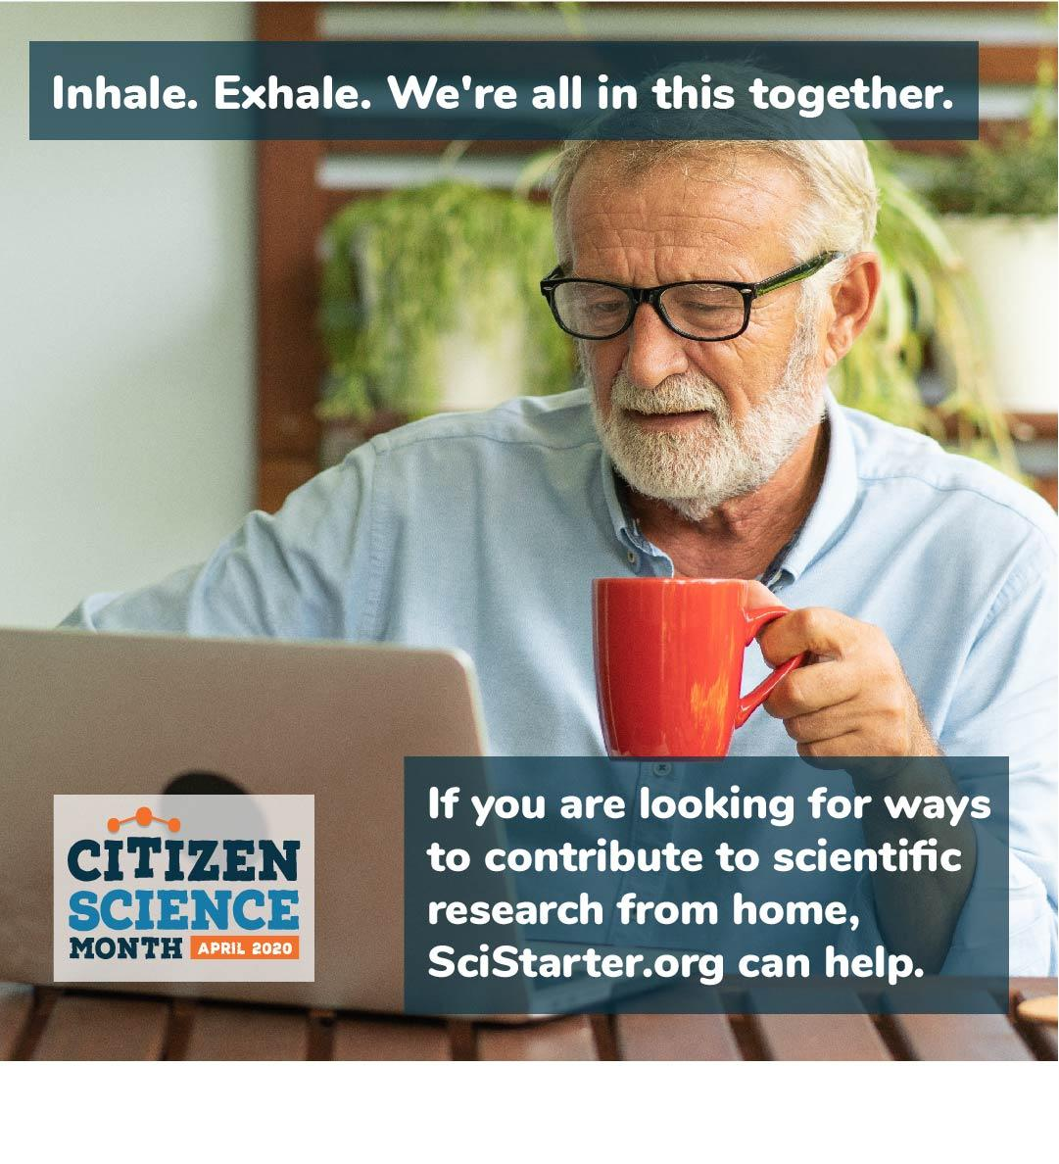
SciStarter: CitizenScienceMonth.org

Slide 14
A 501(c)3 non-profit
Increasing the public’s access to science and scientific information
RADIO - VIDEO - ARTICLES - LESSONS - ACTIVITIES - LIVE EVENTS
www.sciencefriday.com

Slide 15
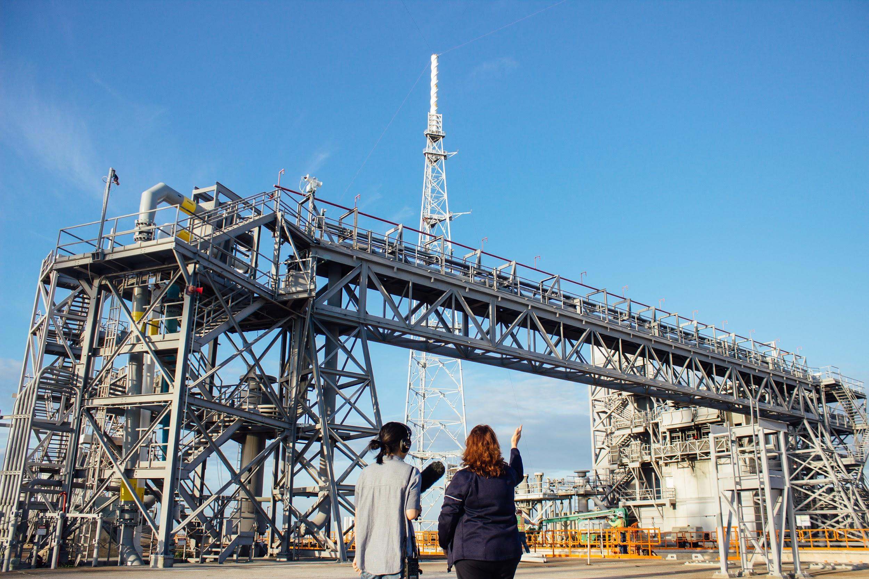
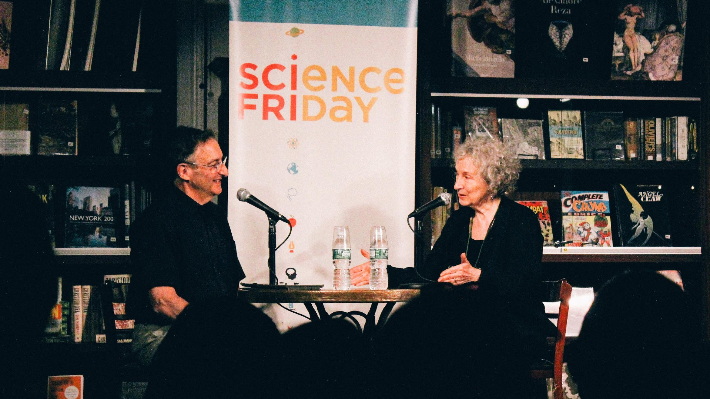
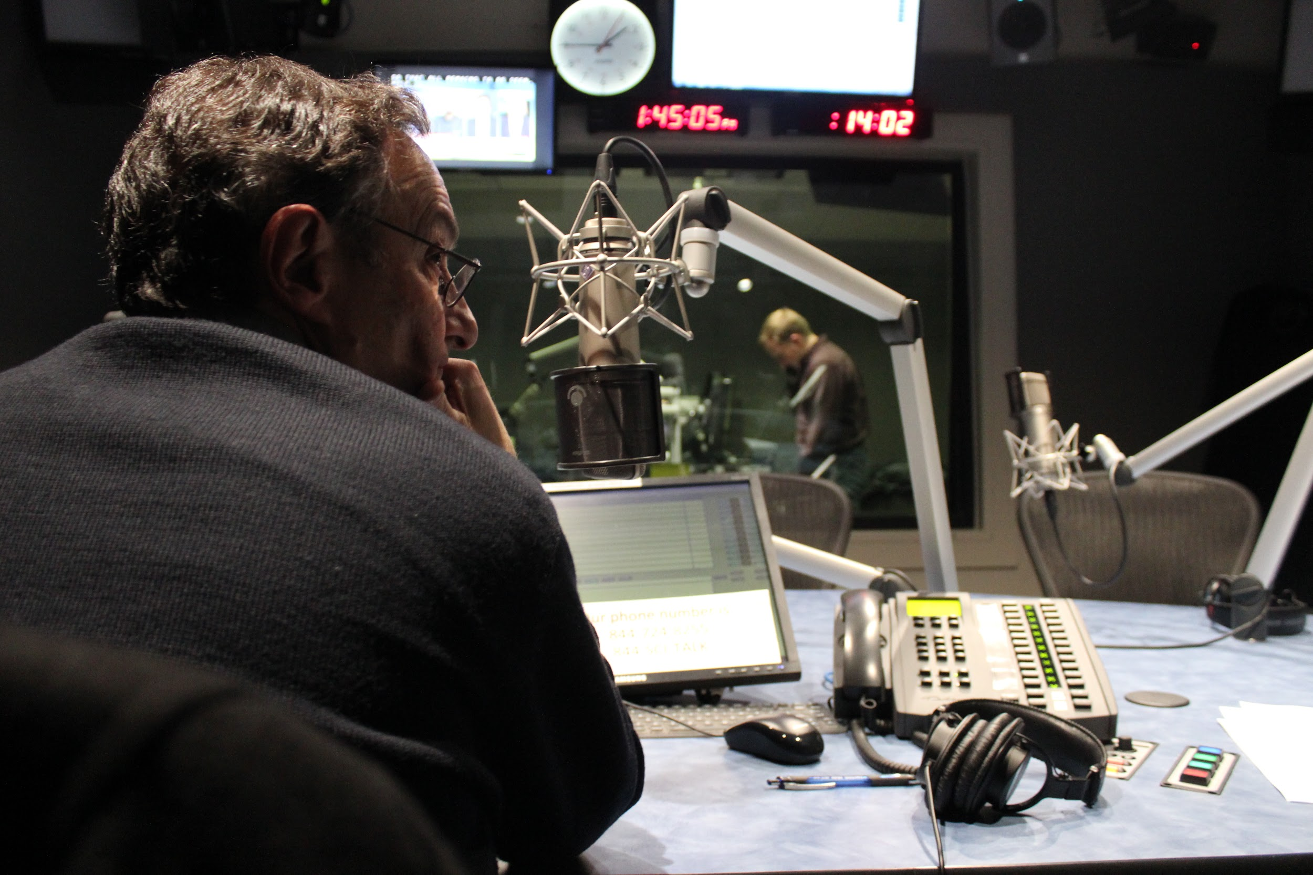
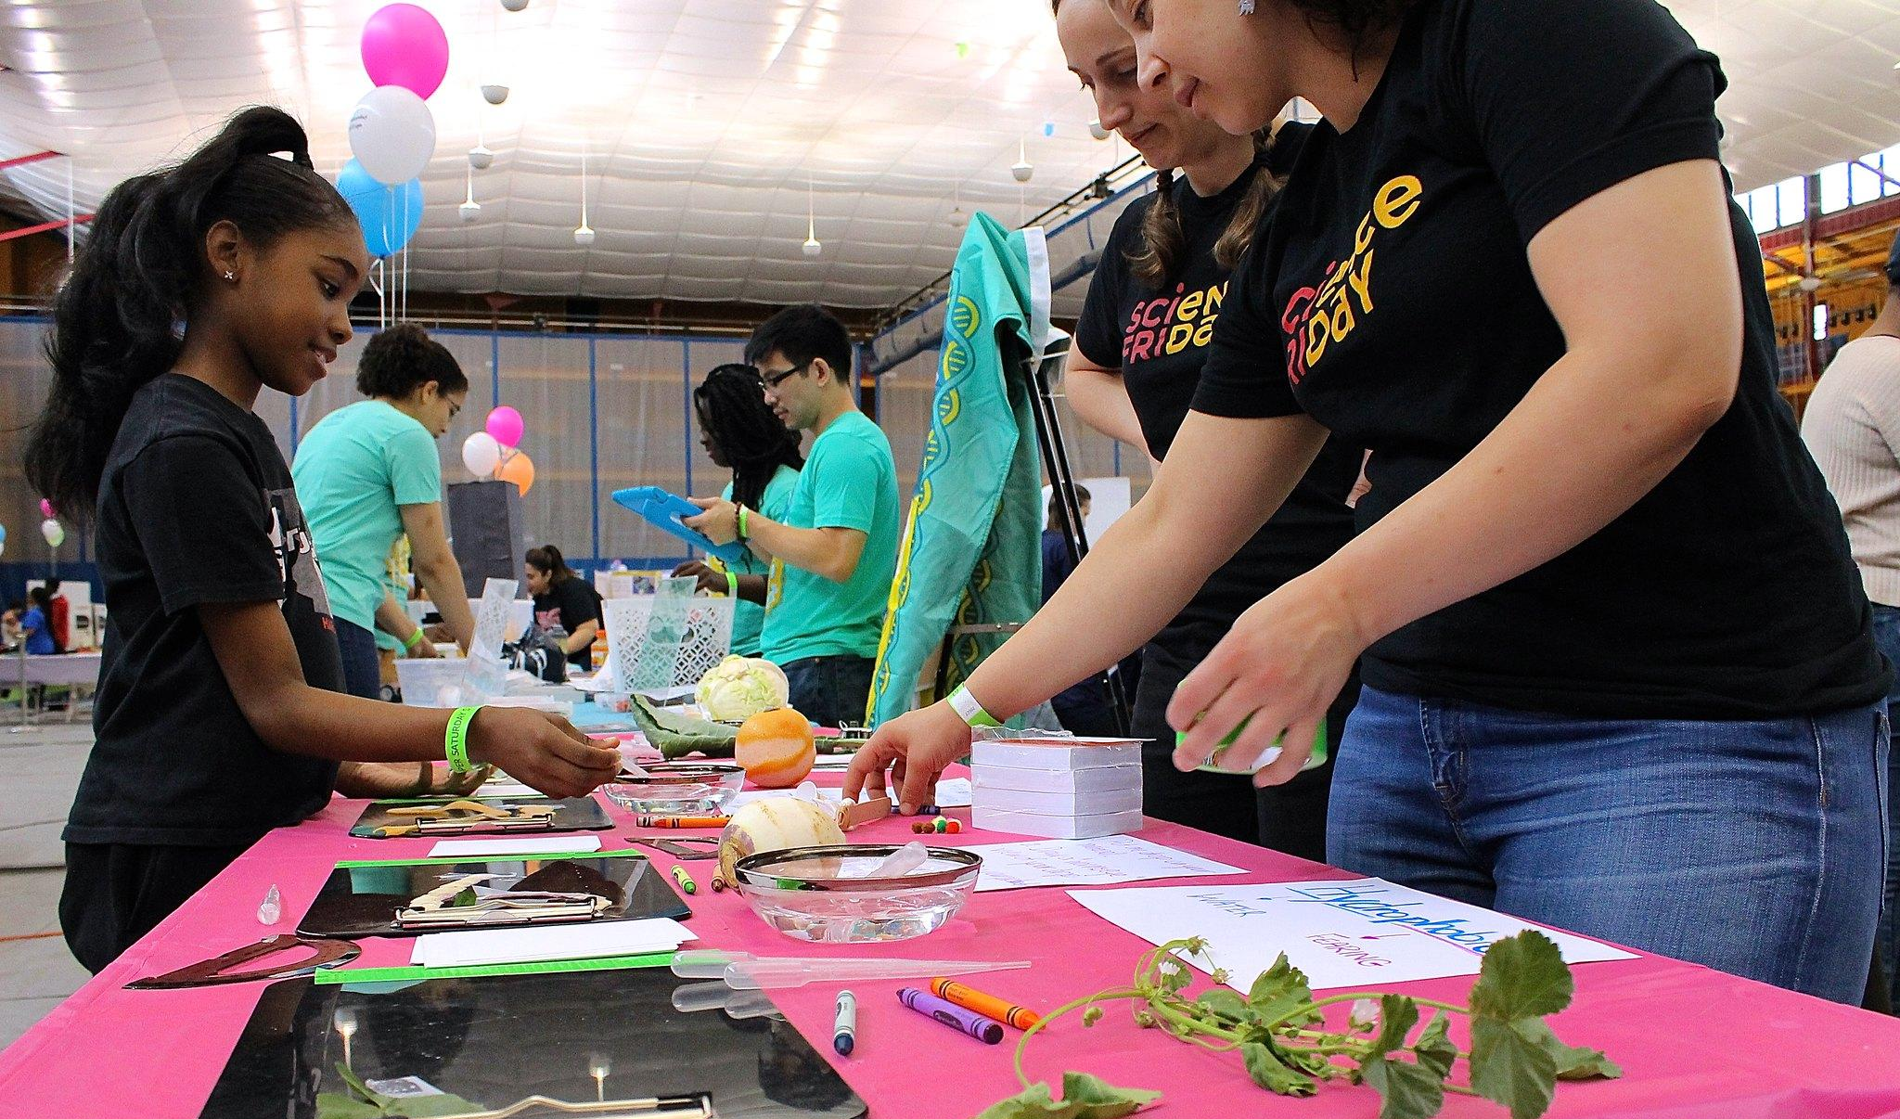
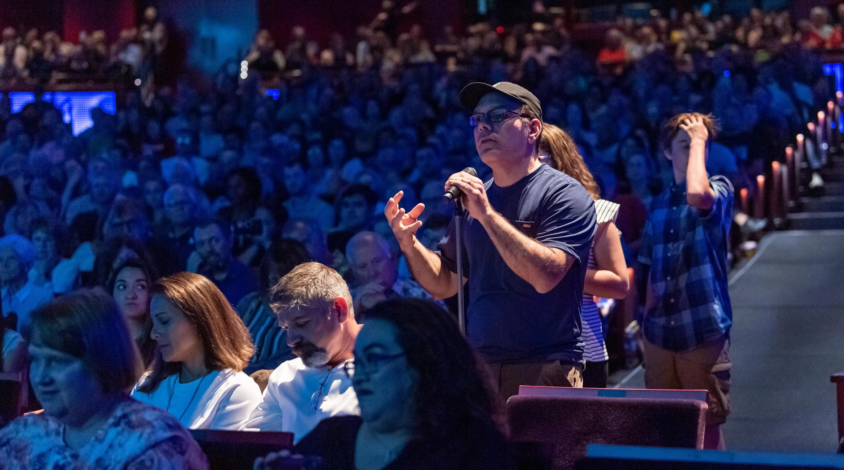
Notes:
----- Meeting Notes (6/19/17 12:13) -----
slide before this with a bunch o scifri projects

Slide 16
Livestream planning
should feel like
normal planning.
Content
Culture
Logistics
Leave nothing out.
Make no excuses.

Slide 17
Content
Know your audience
Establish objectives
Give your audience control
Part 1:
What’s the point?

Slide 18
Know Your Audience
Profession - Family Role - Age - Needs - Assets - Location - Context - Skills - Quarantine - Internet
“Informal educators who had planned on facilitating an in-person citizen science experience, now forced to learn livestreaming”
“Experienced facilitators who strongly prefer in-person stuff”
“Total weirdos I’ve never met who will probably just type cow repeatedly in the chat window”

Slide 19
Establish (Audience-Serving) Objectives
Audience → Objectives
Experience livestream techniques that replicate meaningful interactions
Get tactics for connecting with their audience
Be confident they can bring their whole practice to their livestreamed events.
“Experienced facilitators who strongly prefer in-person stuff”
🙈 🙉 🙊 👀 🙋🏻‍♀️ 🦚 🤸‍♀️ 🔥
Notes:
Left side is audience

Slide 20
Give Your Audience Control: SciStarter.org/NLM
Notes:
Stall catchers logo - throw to Caroline

Slide 21
More Ways To Give Your Audience Control:
Polling
Registration Q’s
Chat prompts
Voices! (unmuting)
Cameras on
Social integration
“What should we do?”
User-generated content
Share-out shares
Amplify audience input
Do a thing, ask what happens
Make a prediction
Give awards

Slide 22
More Ways To Give Your Audience Control:
Polling
Registration Q’s
Chat prompts
Voices! (unmuting)
Cameras on
Social integration
“What should we do?”
User-generated content
Share-out shares
Amplify audience input
Do a thing, ask what happens
Make a prediction
Give awards
Play games
This is like Pokémon - try to catch ‘em all

Slide 23
Culture
To all hosts: Be yourself 🐝
Moderation matters
Play with format. Somuch.
Part 2:
How should we feel?

Slide 24
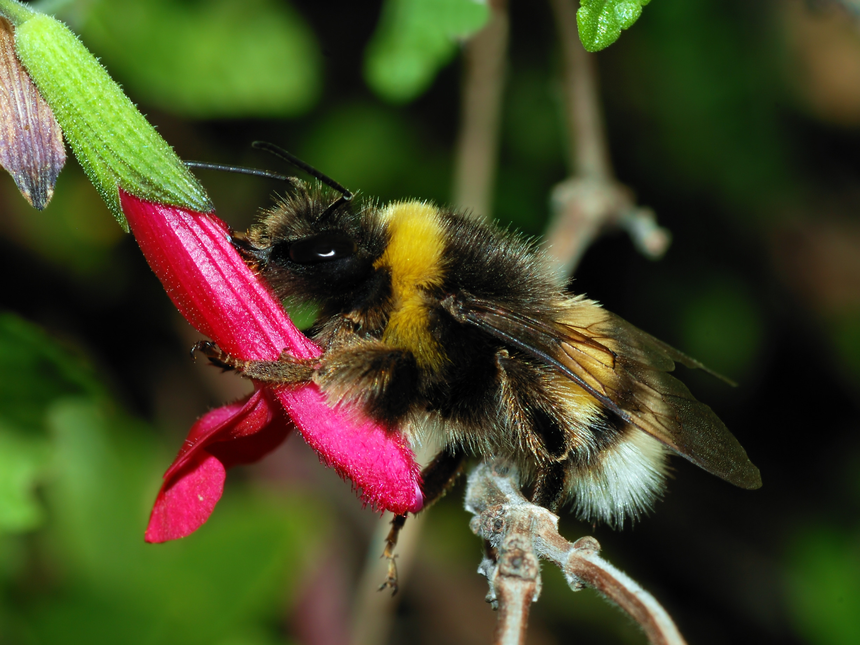
Bee yourself
By Alvesgaspar - Own work, CC BY-SA 3.0,
“I love the color pink, and flowers, and sweets, and pollen…”
How do you share your personality with your learners, trainees, and participants?
Background, nerd shirt, foodstuffs, accent, hair, earrings, audio (music), props, talismans, hats,
Notes:
Nerdy Media - hugging a tree Ask -
Backdrop - I brought props with me (also should be busy)

Slide 25
Moderation! H*ck yeah!
Video, Voice, Chat, or Passive?
Participant # (chat <100)
How much swearing do you mind?
Avoid video, audio of minors w/o consent ☝️
Technical difficulties?
Know your platform’s capabilities in advance!
Expel, mute, and block bad actors
Establish norms, enforce them
Surface awesome
Highlight audience input!
Staff for moderation
reading + hosting + booting meanies + tech support
What concerns do you have about moderation and facilitation? (share in the chat, let’s figure this out!)

Slide 26
Your Concerns Related to Moderation:
Moderating when alone
How do you handle moderation after the fact? When people do not tune in right away.
Establishing Norms
Handling quick chat flows
If you’re saving questions for the end, do you have one person writing down the questions as they appear in chat and then handle them at one time? Or is it better to bring answer in real time?
Do people ever fill out photo release waivers like they would at an in-person event?
Can you designate anyone to be moderator with expel/mute/block privileges or do they have to have an account or be a panelist?

Slide 27
Format:
SciStarter.org/NLM
“Helping create a national inventory of water pipe material.
What materials were used to make your water pipes?”
Notes:
Crowd the tap demo here Caroline - spotlight the hands video

Slide 28
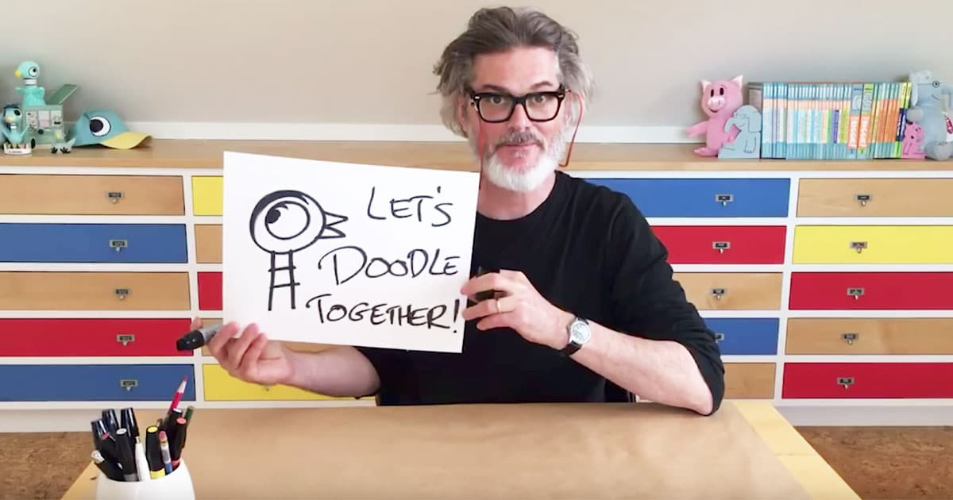
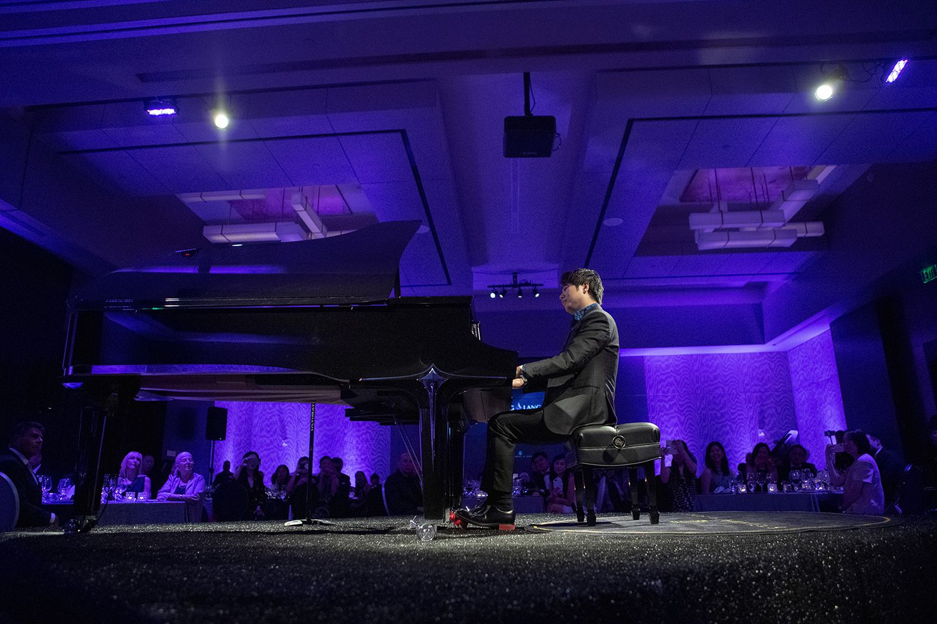
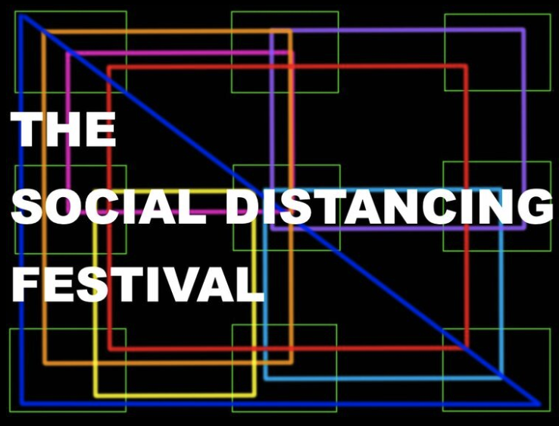
Format - Go 🎡 Crazy
Field trips
Desktop demos
Get zany (Puppets, etc)
Use multimedia!
Group photos and activities
Breakout rooms
Performances
Magic tricks, backgrounds
Music, art, books, tarot, cooking
What else can we do?!

Slide 29
VOTE! What’s your favorite platform?
As either a viewer or a host
Zoom
Facebook Live
Google Hangouts
YouTube Live
Go To Meeting
Cisco WebEx
On24
Instagram Live
Other? Chat!

Slide 30
Logistics
Map platform functions, pick one.
Master your livestream platform
Make your livestream accessible
Part 3:
How is this going to work?

Slide 31
Quick disclaimer*
What follows are suggestions, unpaid and unsolicited and subjective - yay!!

Slide 32
Small group chats: Free Google Hangouts
What it does
< 10 video participants
Unlimited time
Chat
Linking and scheduling
Join by phone or URL
Ideal contexts:
Internal meetings
Small quick gatherings of people
Lots of screensharing, not lots of faces
Really great for meetings of 3 people
Notes:
URL
Cost
Accessibility
Registration Y/N
Polling Y/N
Multi-host or single host
Interactivity Control
Stream to multiple platforms

Slide 33
Community Building: Free Zoom
What it does
< 100 video participants
<40 minutes per group session ($15/month for 24hr meetings)
Unlimited 1 on 1 conversations
Join by telephone or URL
Virtual background
Hand raising, muting participants
Chat, breakout rooms
Scheduled meetings
Screensharing
Ideal contexts:
Communities of (non anonymous) people
Varying levels of internet connectivity
Seeing faces!
Facilitating conversations with a large, but not massive group
Short, not super long, meetings
Notes:
URL
Cost
Accessibility
Registration Y/N
Polling Y/N
Multi-host or single host
Interactivity Control
Stream to multiple platforms

Slide 34
Dedicated Following: Periscope/Facebook Live
What it does:
Unlimited viewers
Broadcast to followers or all users*
Commenting
Fun emoji!
Single camera on host, all other users off-camera
Join by URL only
Non-anonymous commenting (@’s only)
See also: Instagram Live, Twitter Live
Idea contexts:
Broadcasting a single view to a social media following
Limiting participation to comments and emoji (no video/audio)
Reaching new audiences by sharing between audiences
Notes:
URL
Cost
Accessibility
Registration Y/N
Polling Y/N
Multi-host or single host
Interactivity Control
Stream to multiple platforms

Slide 35
Giant interactive events: Zoom Webinar
What it does:
All the free zoom stuff
+ 500 ($140/mo) up to 10K participants
Ability to broadcast to Facebook Live and YouTube live simultaneously
Recorded sessions with engagement and retention analytics
More presentation and moderation tools
See also $$$$: Crowdcast, On24, GoToMeeting
Ideal contexts:
Events with a LOT of participants raising hands, chatting, talking, and sharing
Trainings, large workplaces, national organizations, conferences, fee-based events
Divided audiences: 20% people you trust 80% random people on the internet
Staffed teams - usually takes 2-4 people to host, moderate, and provide tech support

Slide 36
Things to think about when choosing:
How many participants?
How many hosts do you need?
What level of interactivity do you want participants to have?
Audio
Video
Chat
Emoji/claps/stars/likes
Social
How many people can help you moderate?
How many different viewing URL’s?
Do you have a social media audience that wants to see it?
What level of control over content do hosts have?
Slide advances
Media playing
Muting/Unmuting/Booting
How many places/platforms will your audience be?
Do you anticipate internet connectivity issues? (might want a call-in option!)
What’s your budget?

Slide 37
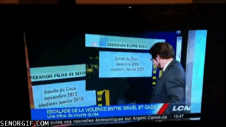
Pick a platform, try it
Attend a stream
Screen capture everything
Host your own (private) stream
Host a practice stream with colleagues as hosts/participants
Schedule a rehearsal stream, test registration, links, and interactivity.
Schedule and host a public livestream 🎉
Ask participants how it went.
Notes:
“The best camera is the one you know how to use”

Slide 38
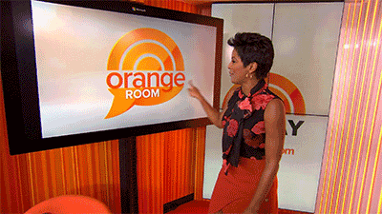
It’s ok if you end up being a gif

Slide 39
Accessibility
Last thought, first felt

Slide 40
Accessibility
Slow internet? Zoom + Hangouts offer call-in options for audio Closed captioning? Google Slides does live captioning, and works with most livestreaming platforms👇 Think about an ASL interpreter! Fonts? High contrast, but avoid loud colors. Larger is better
Recording? Post it, along with your slides!
Notes:
Link to accessible presentations

Slide 41
Bonus: Accessibility tools
Google Slides - live captioning!
Otter.ai - pretty great automated transcription, lots for free!
Google translate… and volunteers in your community
Others that you love?
Notes:
Link to accessible presentations

Slide 42
It’s Citizen Science Month
Let’s do this.

Slide 43
Find a project or theme to spotlight during your event via CitizenScienceMonth.org or SciStarter.org/nlm.
1.
Notes:
Caroline

Slide 44
Find a project or theme to spotlight during your event via CitizenScienceMonth.org or SciStarter.org/nlm.
1.
Need help with your event? Don’t have a zoom account? Join one of our weekly calls via SciStarter.org/CitizenScienceMonthFAQ
2.
Notes:
Caroline

Slide 45
Find a project or theme to spotlight during your event via CitizenScienceMonth.org or SciStarter.org/nlm.
1.
Need help with your event? Don’t have a zoom account? Join one of our weekly calls via SciStarter.org/CitizenScienceMonthFAQ
2.
3.
Add your event to SciStarter via SciStarter.org/add-event.
Notes:
Caroline

Slide 46
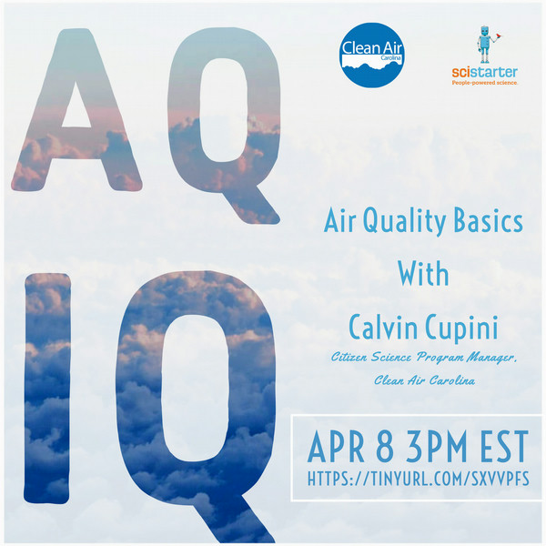
Example! In-Person to Virtual
SciStarter.org/Events

Slide 47
Open Floor
Throw it in the chat, let’s talk

