Slide 1
Want to view a recording of this webinar?
View recording here.
Feel free to download these slides and edit them as you see fit for your programs!

Slide 2
Citizen Science Month (and Beyond!) at Your Library
November 14, 2019
The webinar will begin at 1:00 p.m. (MT) and will be recorded.
While you’re waiting
Find the toolbar – it will either be on the bottom or top of your Zoom window
Introduce yourself in the chat box (please select “Share with All” not “Share with Panelists”)
Click audio “Join by Computer” – you won’t have microphone access
Tip for viewing: You can resize and move the location of the video and slide screens by clicking and dragging them

Slide 3
Facilitator Introduction
Brooks Mitchell (Space Science Institute)
Claire Ratcliffe (Space Science Institute)
Caroline Nickerson (SciStarter)
Dan Stanton (Arizona State University, SciStarter)
Robin Salthouse (Southeast Regional Library)
Vivienne Byrd (Los Angeles Public Library)

Slide 4
Today’s Agenda
Welcome/Intro
Clearinghouse Overview
What is Citizen Science?
SciStarter
Case Study: Citizen Science at Southeast Regional Library in Gilbert, AZ
Case Study: Citizen Science at the Los Angeles Public Library
Citizen Science Month 2020
Wrap-up and Final Discussion

Slide 5
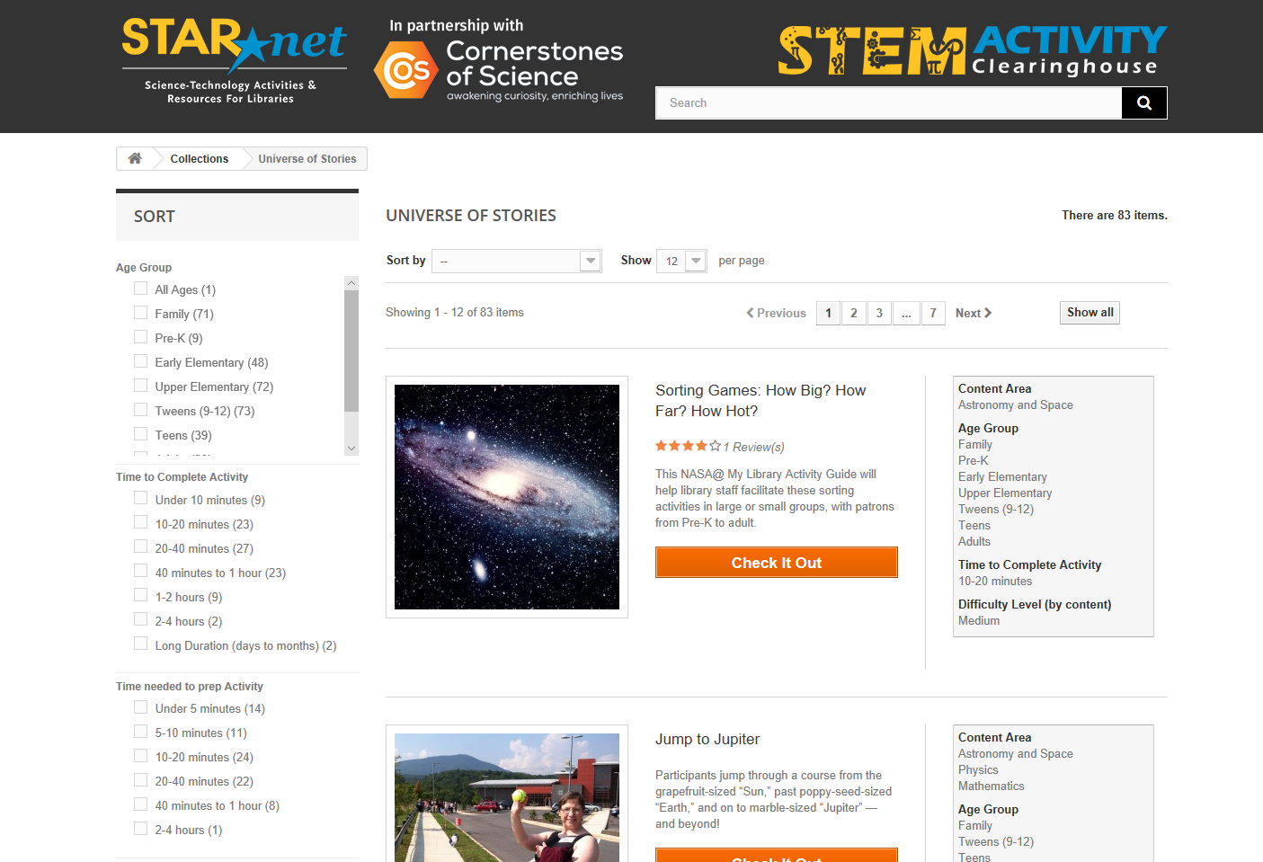
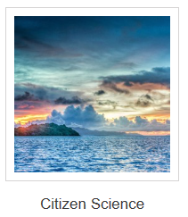
Like an activity and think other library staff should know how great it is? Didn’t like an activity or have modifications to make it better? Make sure to leave a review!
Notes:
Brooks (5 minutes)

Slide 6
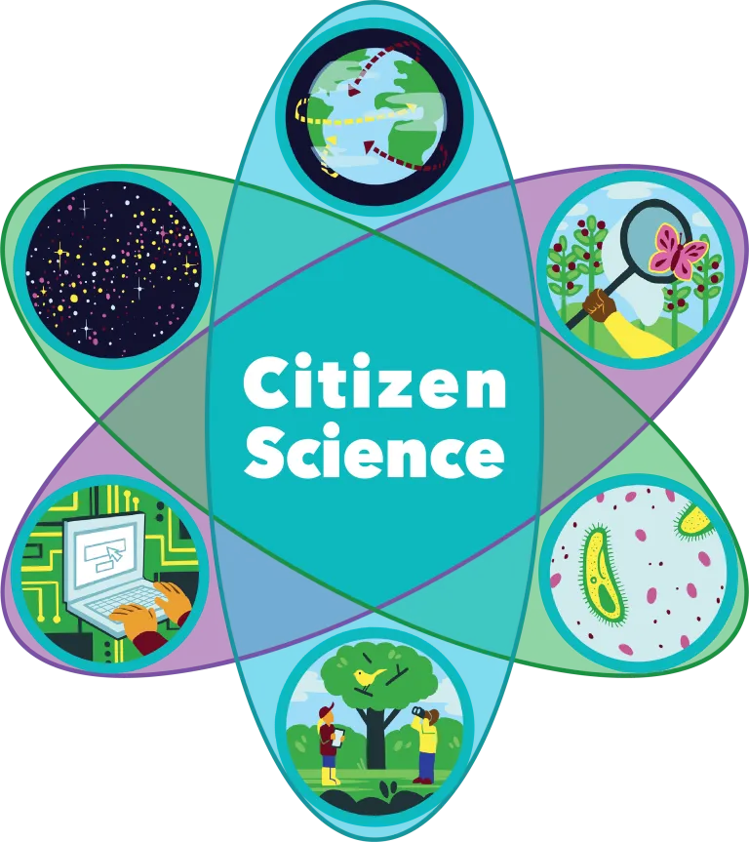
What is Citizen Science?
Notes:
Citizen science is a fairly new term but an old practice.
Prior to the 20th century, science was often the pursuit of amateur or self-funded researchers such as Sir Isaac Newton, Benjamin Franklin, Mary Anning, and Charles Darwin.
By the mid-20th century, however, science was dominated by researchers employed by universities and government research laboratories.
By the 1970s, this transformation was being called into question.
Definitions of citizen science vary somewhat, but common to all is the ability of non-scientists to use science to gather/analyze data to address issues ranging from biodiversity to clean air and water to alzheimer's research.

Slide 7
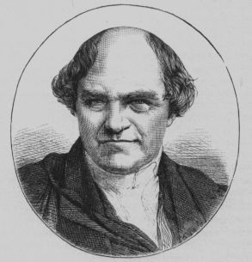
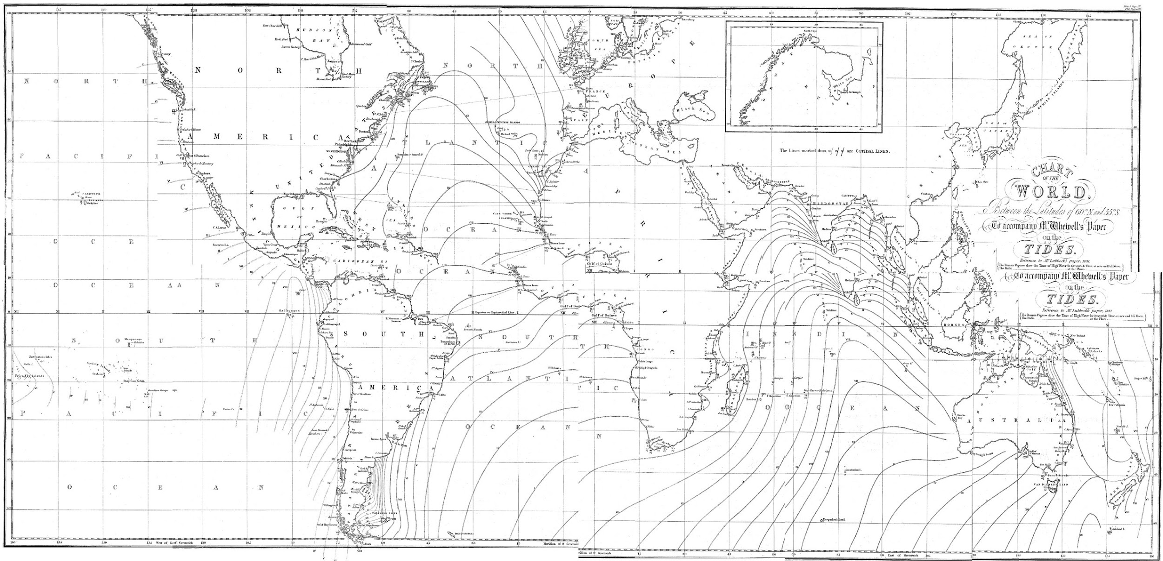
William Whewell
650 Locations Around the World
2 Week Collecting Period
15 Minute Collection Intervals
873,600 Samples, 218,400 Man Hours
Notes:
One great example of the power of citizen science and crowdsourcing is William /Huewell/. Keep in mind that this was done long before cell phones, satellites, and the internet.
With the consent of the British Admiralty, Whewell coordinated thousands of people in nine nations and colonies on both sides of the Atlantic in the synchronized measurement of tides. At over 650 tidal stations, volunteers followed Whewell’s instructions for measuring tides every 15 minutes, around the clock, during the same two week period in June 1835. Volunteers in the “great tide experiment” included dockyard officials, sailors, harbormasters, local tide table markers, coastal surveyors, professional military men, and amateur observers.
Whewell was one learned, academic scholars who pursued science as a profession, having coined the term scientist to distinguish himself from hobbyists. Unfortunately, he also took all the credit for the work that these citizen scientists had done.

Slide 8
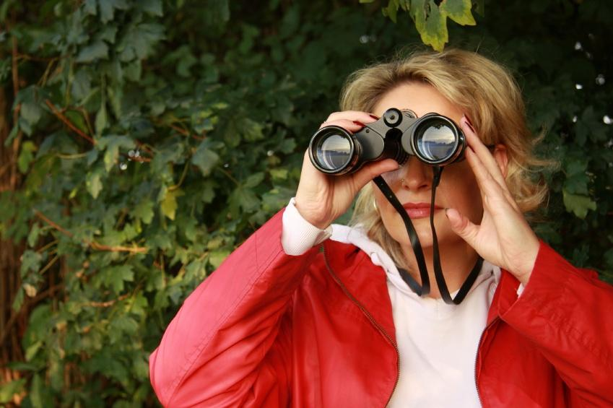
Millions of people enjoy
science and nature.
Thousands of scientists need volunteers.
But they can’t find each other.
Notes:
Even though most of us enjoy science and nature, and may know our communities quite well, much of scientific research is hidden away in universities and labs.
Scientists need data - place and time based observations; the ability to distinguish subtle differences and nuances in data that computers can’t;
8

Slide 9
Libraries can connect
regular people to
real science
they can do.
And advance scientific research in the process!
Notes:
This is a key point of citizen science in the STEM realm - people are not just learning about science, they are actively contributing to *real* scientific research.
9

Slide 10
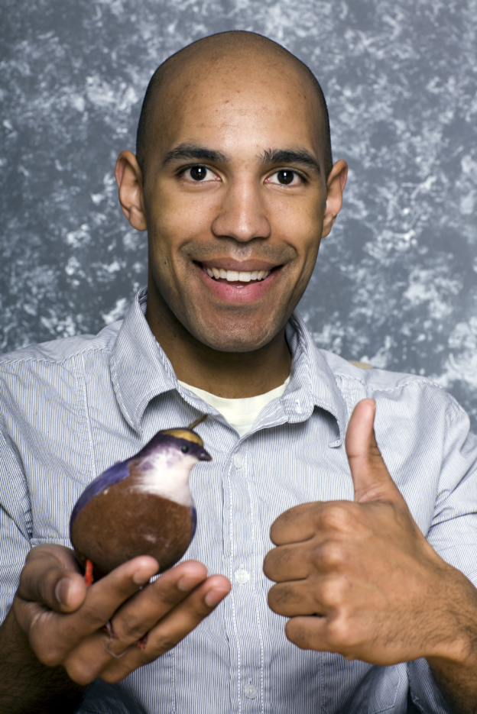
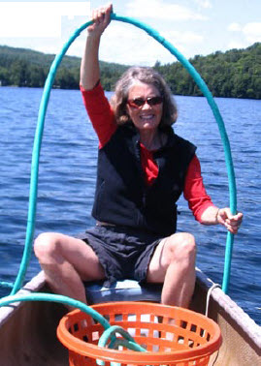
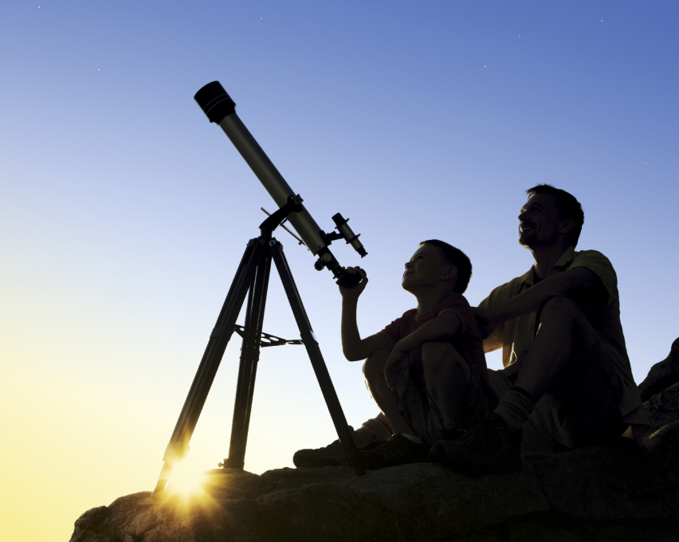
Someone you know is a CITIZEN SCIENTIST
eBird
1.5 million
reports
Water testing
1.5 million
monitors
SETI@home
5 million
volunteers
Notes:
People are contributing to science in ways that Whewell could not imagine!
SETI (Search for Extraterrestrial Intelligence) is a scientific area whose goal is to detect intelligent life outside Earth. One approach, known as radio SETI, uses radio telescopes to listen for narrow-bandwidth radio signals from space. Such signals are not known to occur naturally, so a detection would provide evidence of extraterrestrial technology.
10

Slide 11
Common features of citizen science:
Anyone can participate;
Participants and professional scientists use the same process—or protocols--to make observations and collect, share, and analyze data so the data can be trusted and used;
Data can help scientists and participants advance research and support decision-making;
The public, as well as scientists, have access to and can use the data.
https://www.nap.edu/catalog/25183/learning-through-citizen-science-enhancing-opportunities-by-design

Slide 12
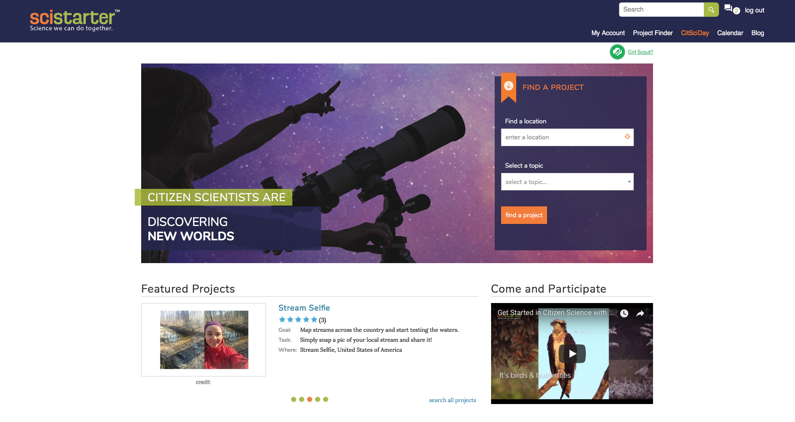
SciStarter is your gateway to more than
3,000 citizen science projects
“SciStarter is the Amazon.com of Citizen Science,” Carl Zimmer, Discover Magazine
Notes:
About SciStarter.
SciStarter is an online community dedicated to improving the citizen science experience for project managers and participants. There are lots of resources including dedicated people!

Slide 13
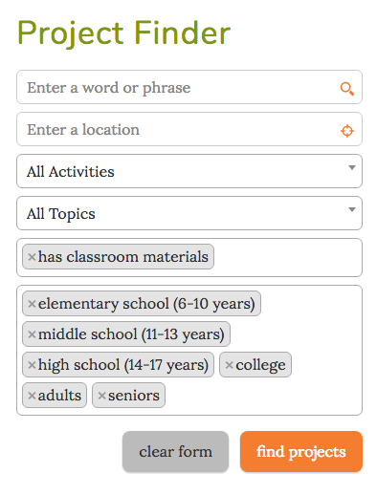
Use the mini Project Finder
on the home page
or the Advanced Search option
to find projects.
Search by:
Activities Location
Indoor/outdoor Interest
Online/offline Age level
Notes:
Over 3,000 projects and events are searchable by location, scientific topic, and age level, and by joining SciStarter, members can track their contributions and provide valuable feedback.

Slide 14
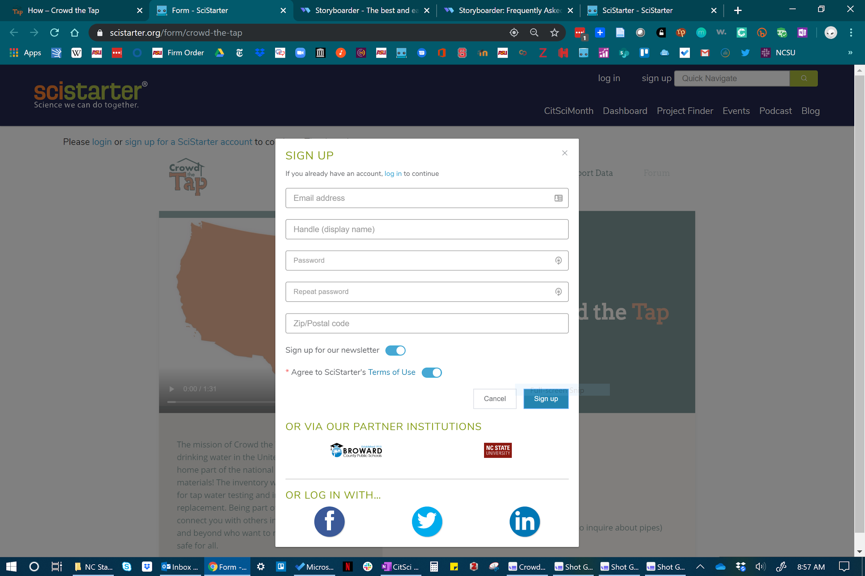
Notes:
Why Join SciStarter?
SciStarter also supports researchers in managing projects, including best practices for engaging participant partners.
An identity management system and open integrated registration for participants to more easily engage in multiple citizen science projects, even across platforms and disciplines
GIS implementation so would-be participants can find opportunities near them
Ability for participants to track their projects, contributions, and volunteer hours to science
Participants can create privacy-protected profiles and find people and projects of interest to them

Slide 15
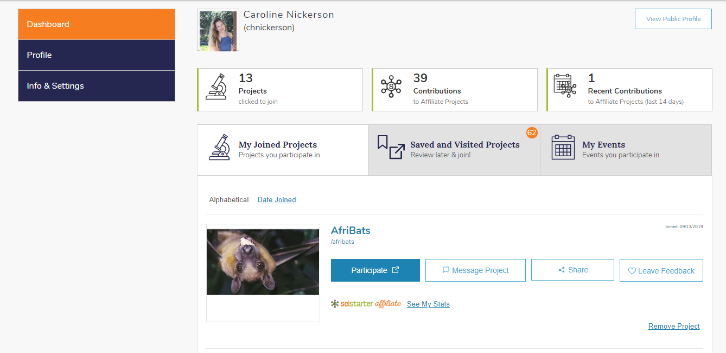
Dashboards
SciStarter: Digital Community Tools
Find recommended projects
Track your contributions across projects
Display your profile and accomplishments

Slide 16
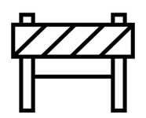
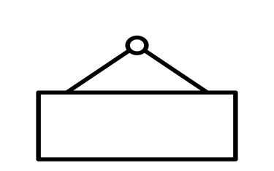
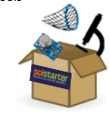
ASU and SciStarter partner with public libraries to advance citizen science.
Lower Barriers to participate in projects that require tools
Help citizen scientists & scientists find & access the right tools
Partner with libraries and museums to curate, bundle projects, tools, instructions into kits so people can do >1 project
Notes:
A couple of the challenges potential participants face are tools/equipment, and a sense of community.
Some projects require specific tools that most people are not going to purchase. Light meter
And while you may participate by submitting observation data, you might feel isolated, that you’ve submitted your information, without really feeling engaged
That’s where libraries come in. And that’s why we thank the Institute for Museum and Library Services for funding our pilot project 2 years ago!

Slide 17
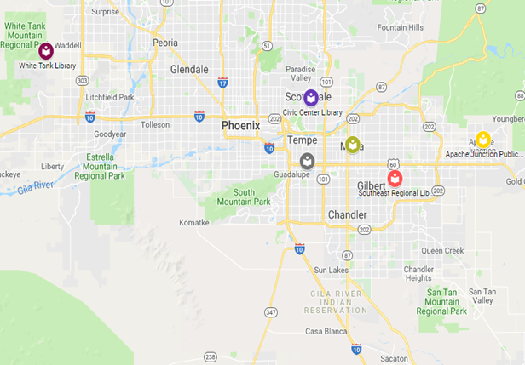
Libraries as
Community Hubs
for Citizen Science
Notes:
Dan
•6 libraries across the valley – 67 miles east to west. Urban, suburban, rural.
•Different library systems, rules
•What is needed for libraries and library users to succeed (information, training, marketing, ease of use)
•Identify good, established Citizen Science programs of interest
And now it is my pleasure to turn it over to one of Rock Star Librarian Partners, Robin Salthouse!

Slide 18
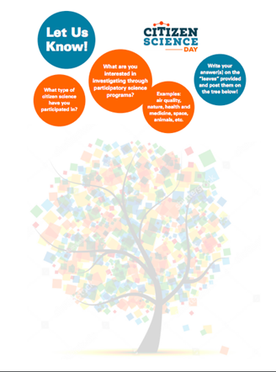
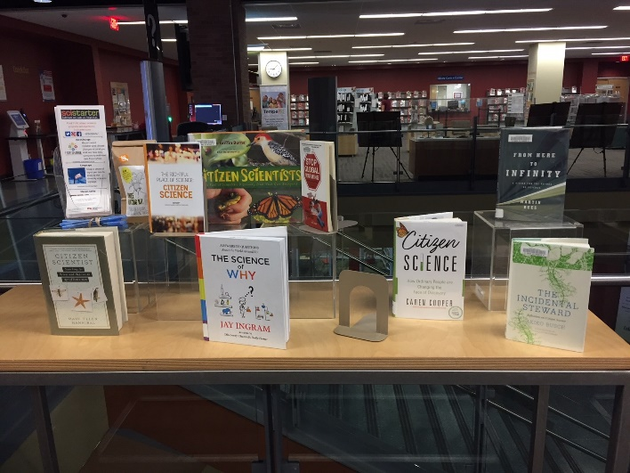
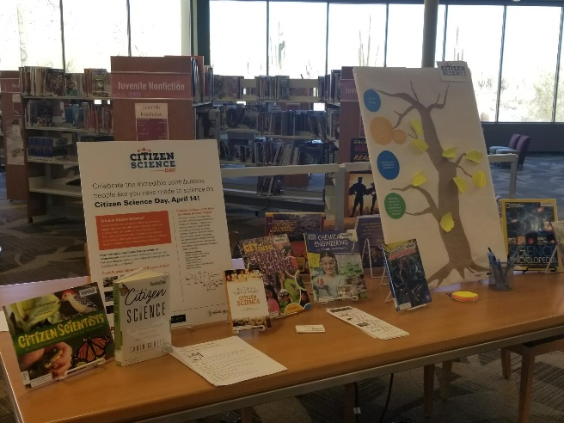
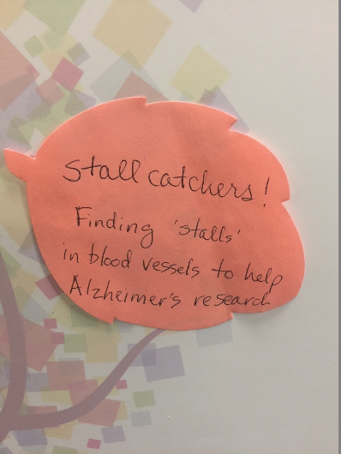
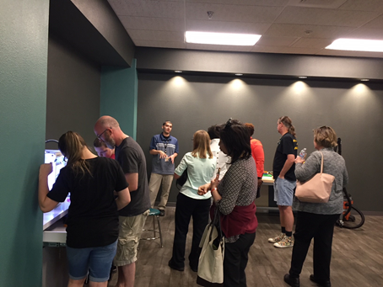
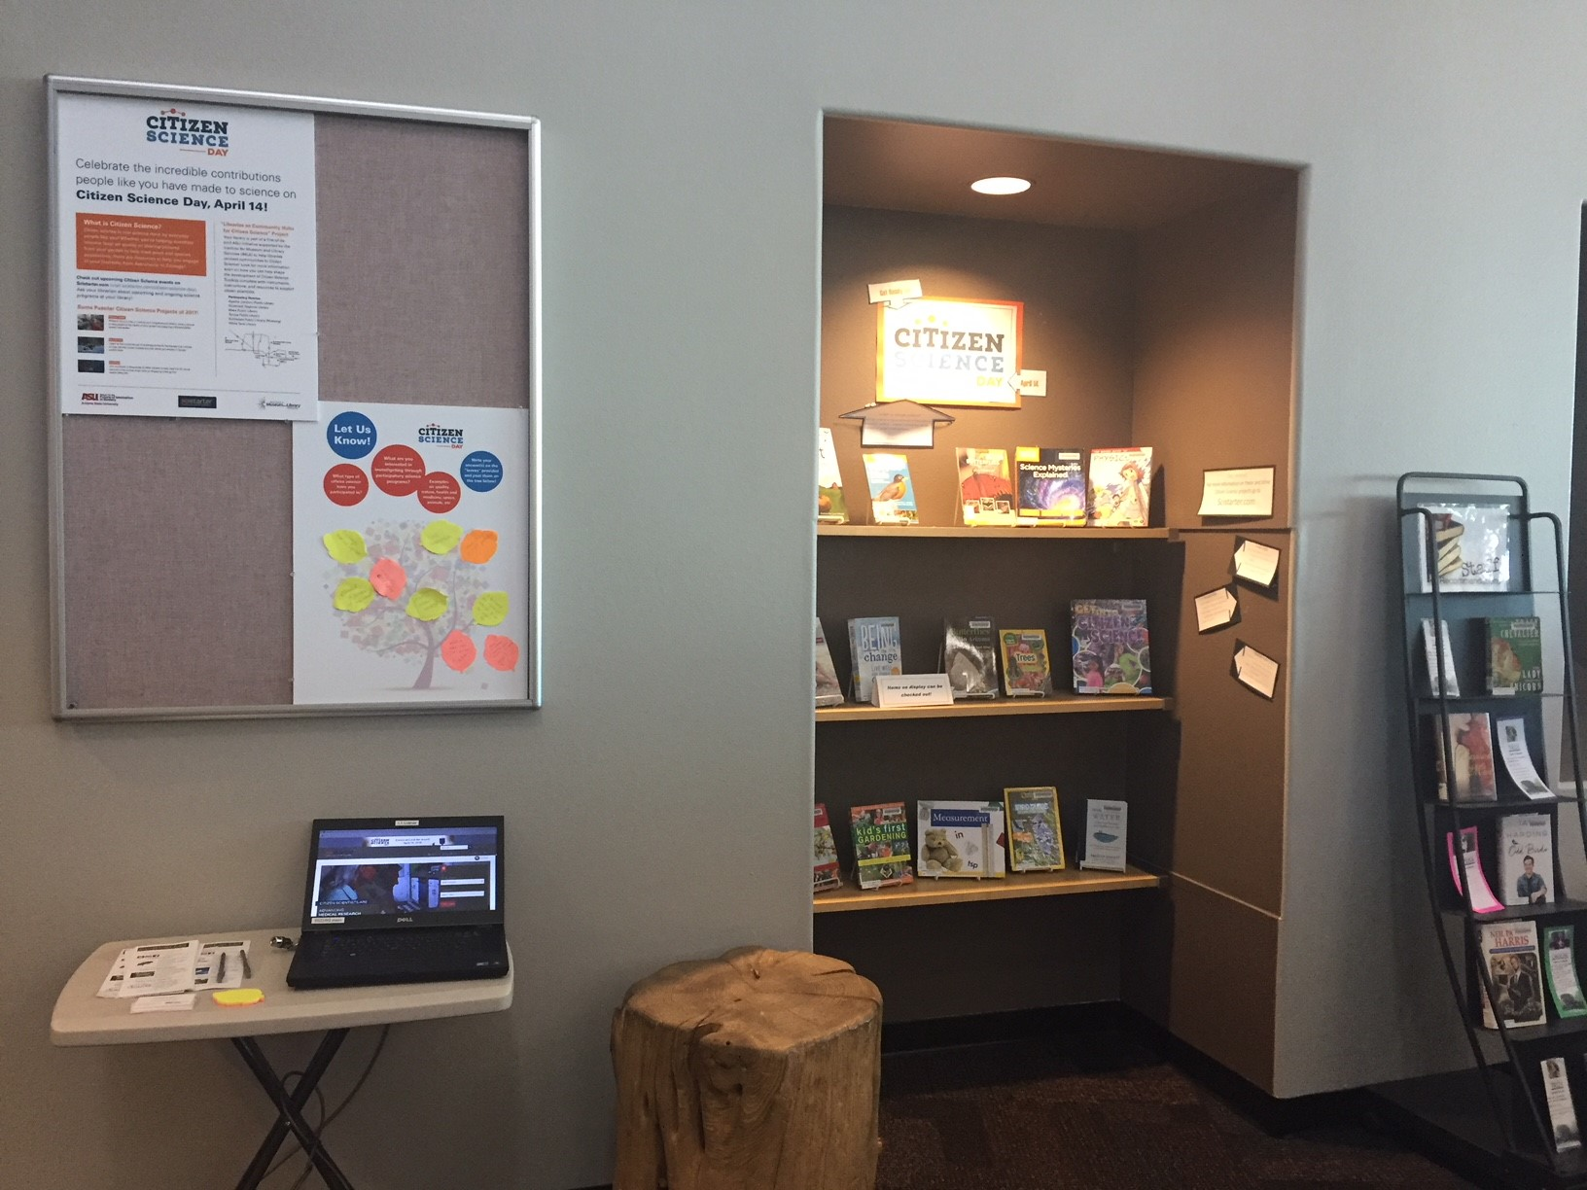
Notes:
Citizen Science Day 2018 -- Robin

Slide 19
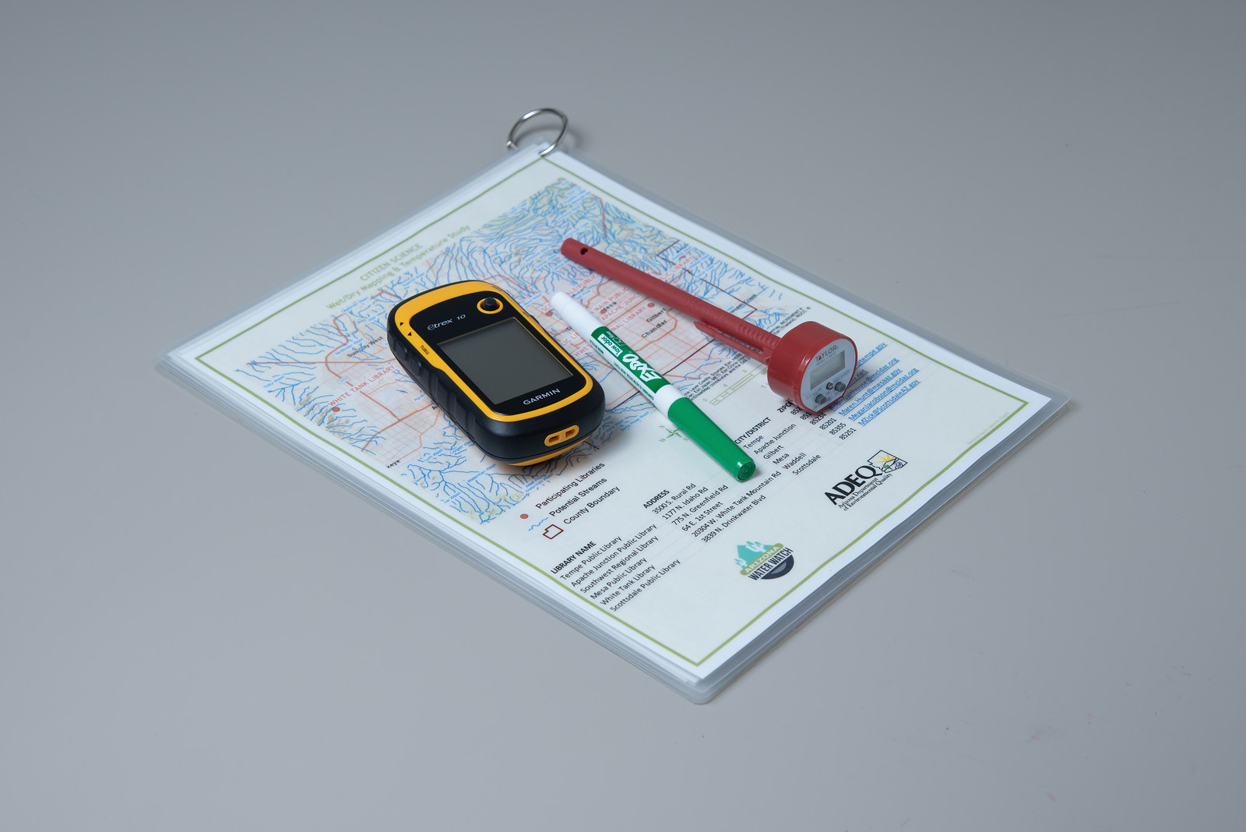
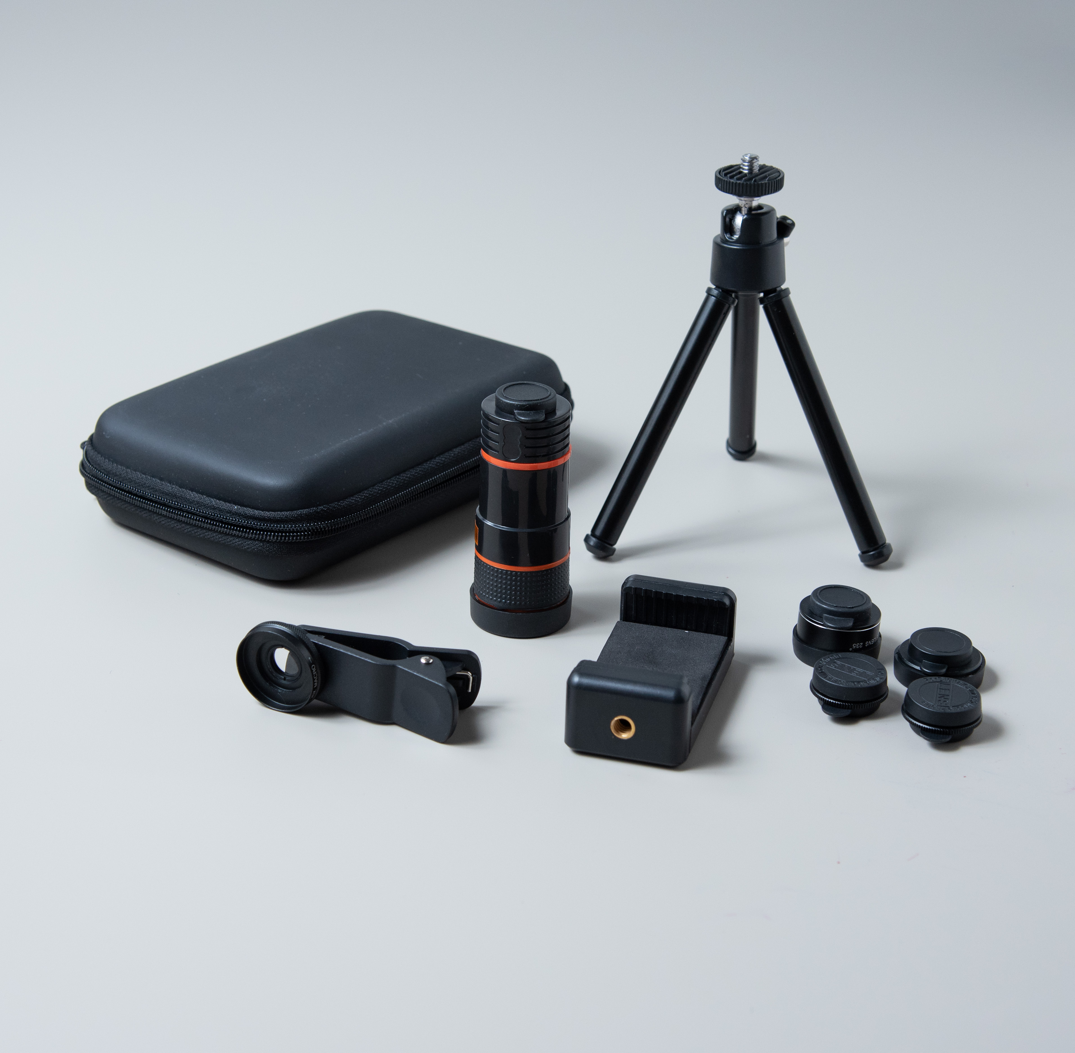
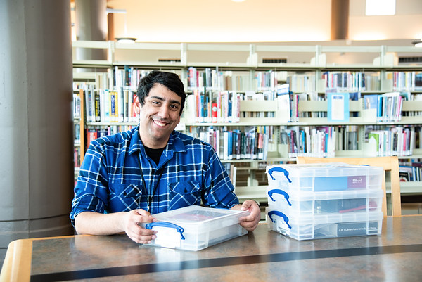
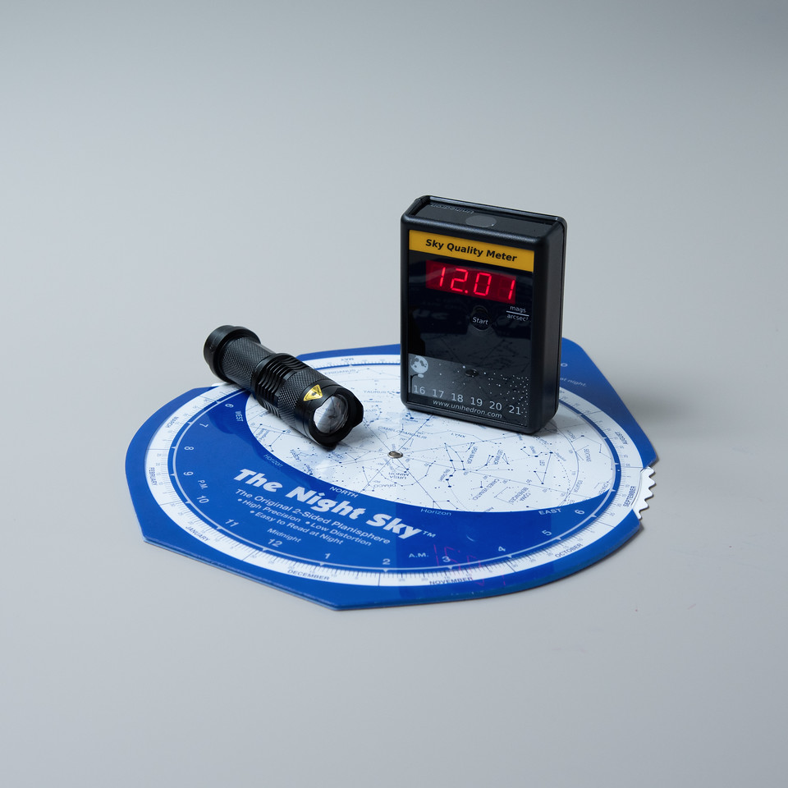
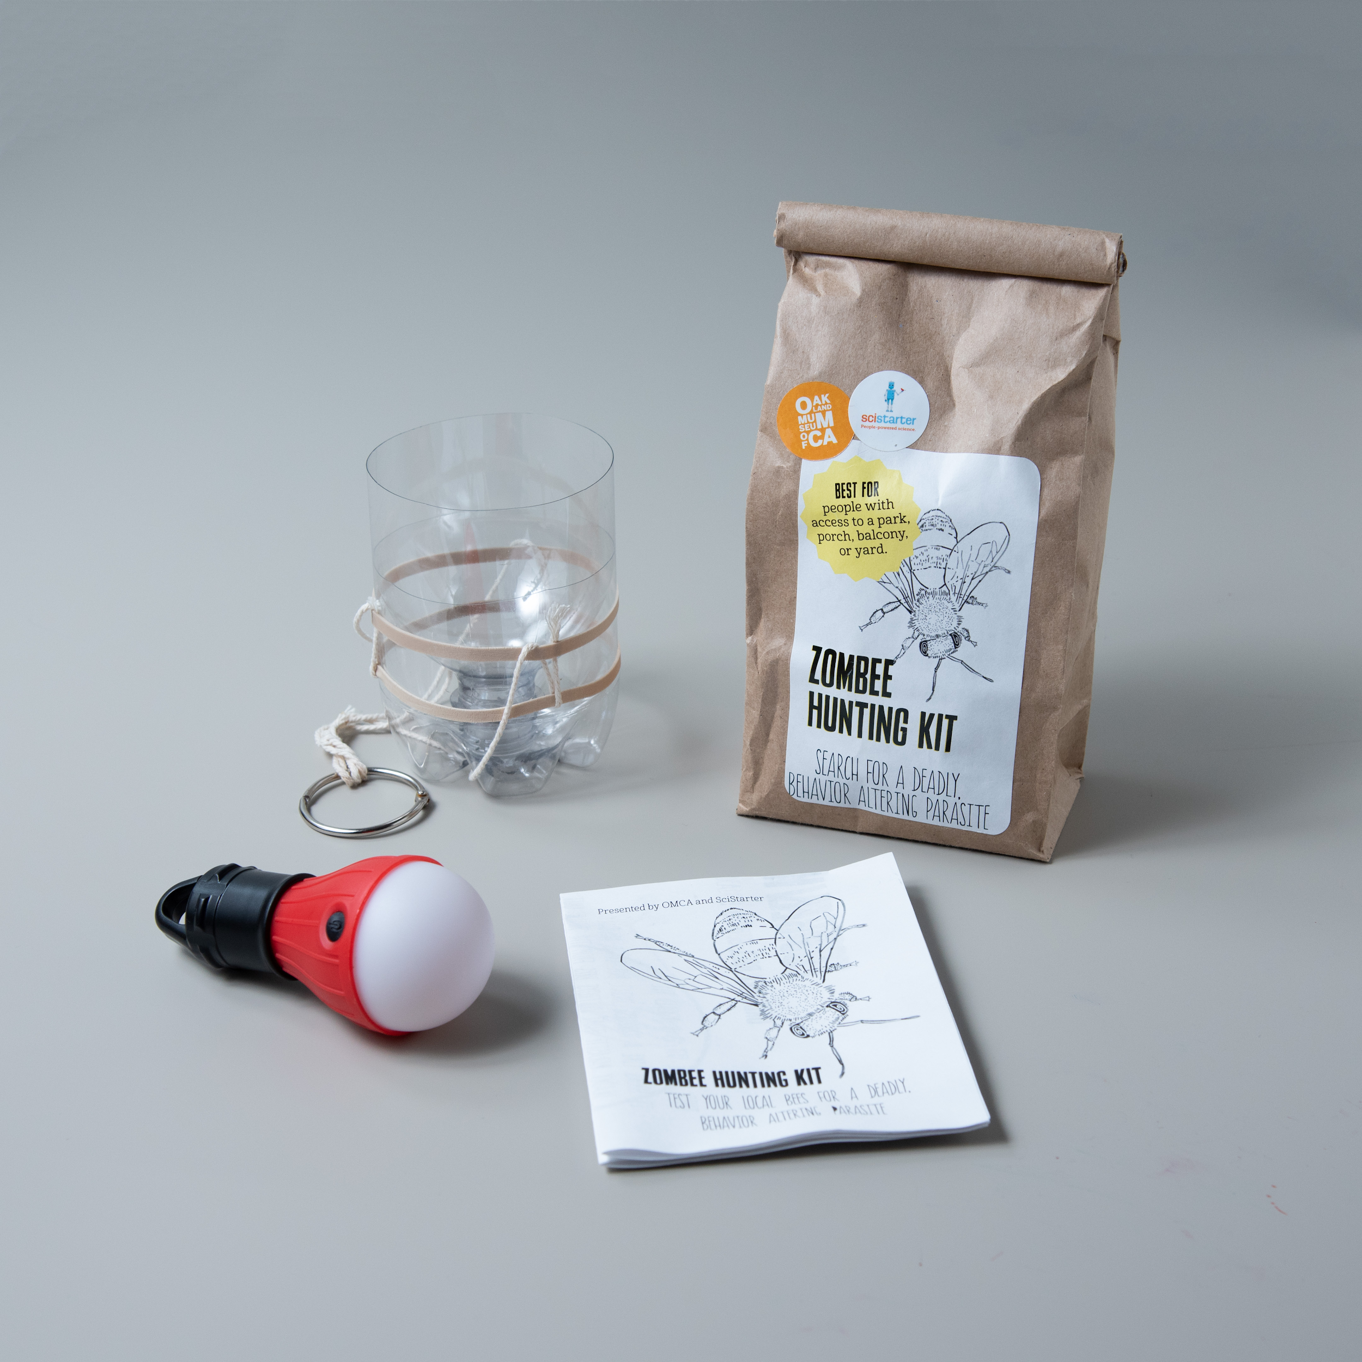
Notes:
Robin
We didn’t just provide tools for the project. We did so in a convenient, ‘value-added’ way:
Good instructions for library staff and patrons
‘Extra’ information related to the project topic
Reasonable, self-contained packaging for patron and library ease of use

Slide 20
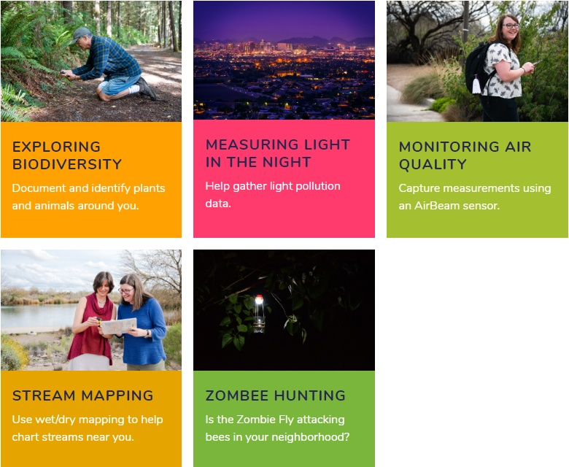
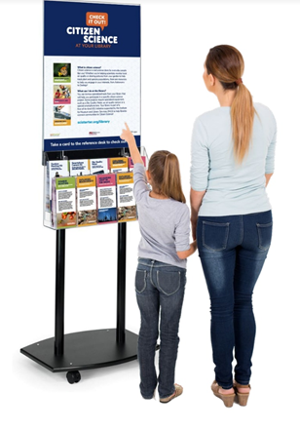
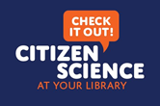
SciStarter.org/library
Notes:
Robin
Marketing kits: Community partners (EVAC), video with brief kit training, one-on-one engagement, program commercials
Binder provided to each library for training and support
Staff training: opportunity for staff to look and use kits, how to find kits in library catalog, checkout/checkin process

Slide 21
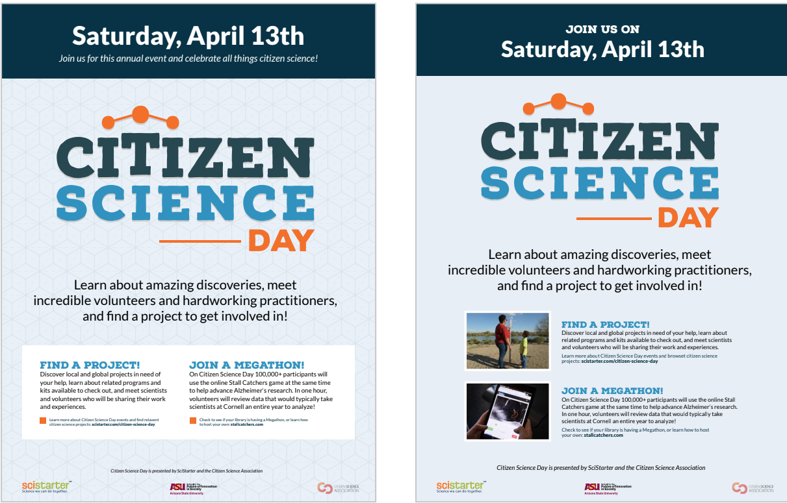
Citizen Science Day 2019
Notes:
Robin - With support from the National Network of Libraries of Medicine Pacific Southwest Region,
We amped it up in 2019. Providing support and resources for libraries across the country
And focusing on an online crowdsourcing project, Stall Catchers.

Slide 22
NeiSci
2.0

Slide 23
2.0
NeiSci 2.0 Kit Types:
Facilitator’s Kit (aka Program Kit)
DIY Circulating Kit
Notes:
The first type is the Facilitator’s kit and the second type is the DIY circulating kit.

Slide 24
2.0
NeiSci 2.0 Facilitator’s Kit
For in-branch or school/community outreach program
The kit contains 12 loanable/circulating sets for librarians to encourage the participants to check them out after the program and return for subsequent sessions.
These sets are only available to attendees of an in-branch or outreach program
Notes:
We are also open to the idea of letting teachers check out the kit to try the program with their students.

Slide 25
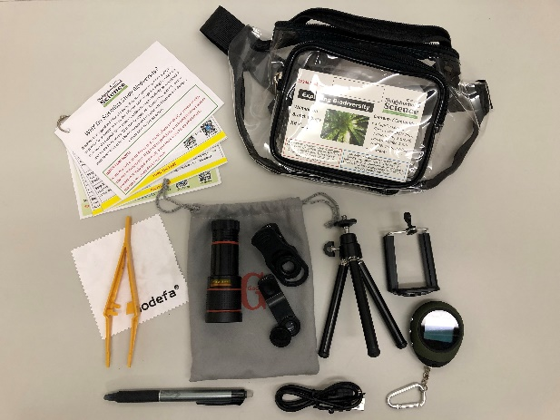
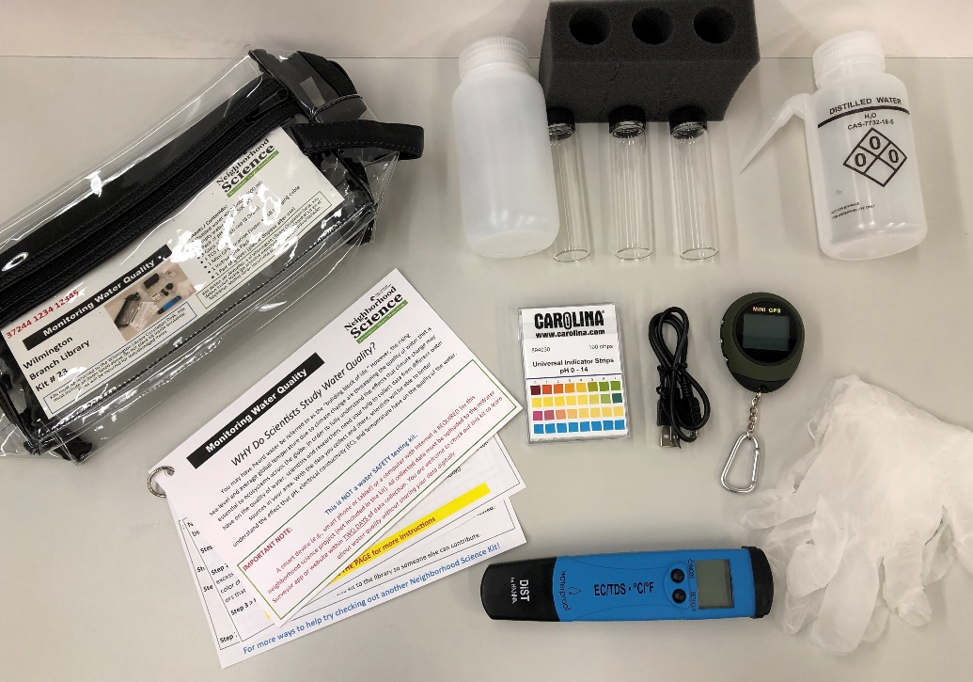
2.0
NeiSci 2.0 Facilitator’s Kits:
Exploring Biodiversity with iNaturalist Kit
Monitoring Water Quality with mWater Surveyor Kit
Notes:
The topics we have as Facilitator’s kits are:
Exploring Biodiversity (iNaturalist)
Monitoring Water Quality (mWater)
Monitoring Air Quality, which will be available next February 2020.

Slide 26
2.0
NeiSci 2.0 DIY Circulating Kit:
For patrons to check out and do their own observation without attending an in-library program

Slide 27
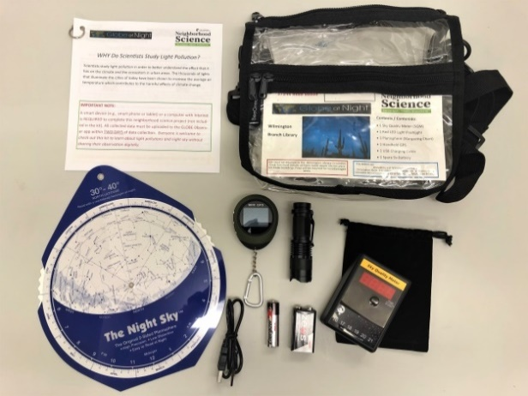
2.0
NeiSci 2.0 DIY Circulating Kits:
Globe at Night Kit
Monitoring Water Quality with mWater Surveyor Kit
Notes:
The topics we have as DIY circulating kits are:
Monitoring Water Quality (mWater Surveyor)
Globe At Night: Light Pollution Monitoring (Globe at Night)

Slide 28
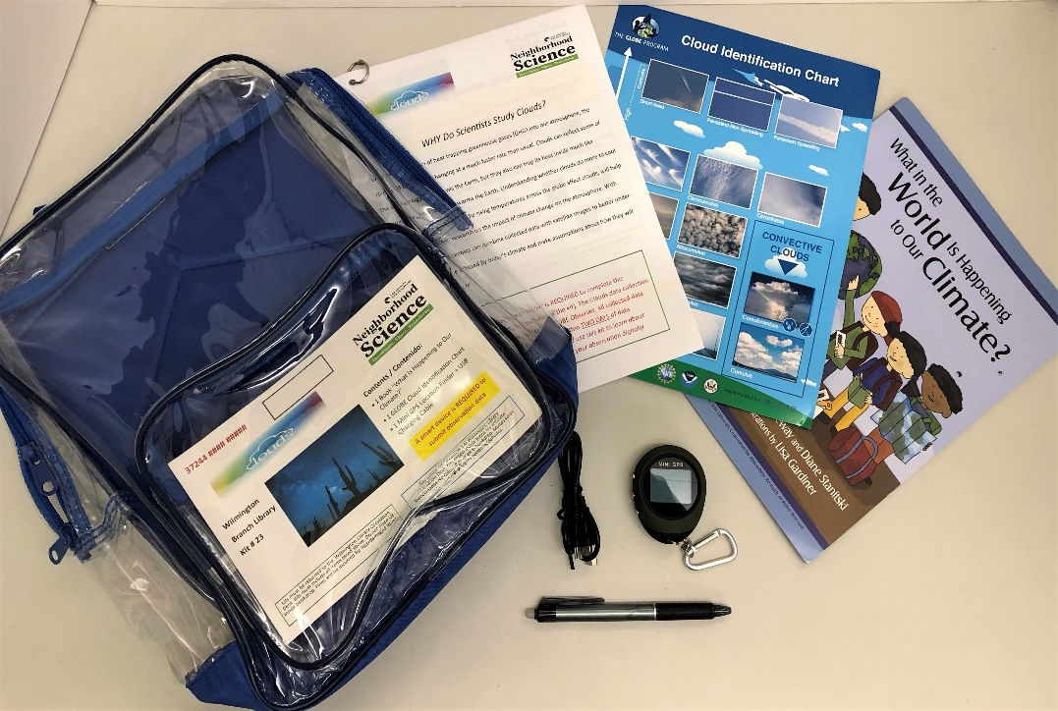
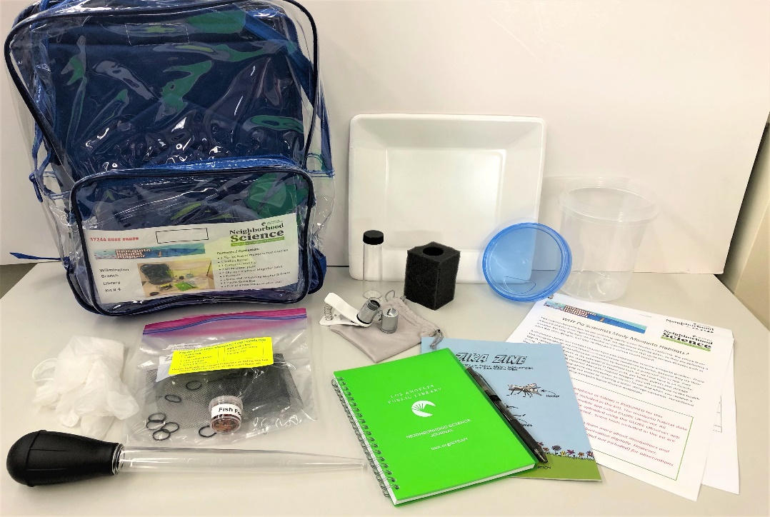
2.0
NeiSci 2.0 DIY Circulating Kits:
Clouds with GLOBE Observer Kit
Mosquito Habitat Mapper with GLOBE Observer Kit
Notes:
Clouds (GLOBE Observer)
Mosquito Habitat Mapper (GLOBE Observer)
The only one not showing here is again the Monitoring Air Quality, which will be available February next year.

Slide 29
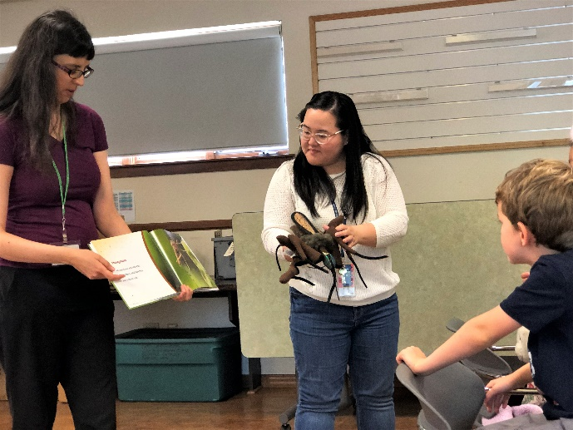
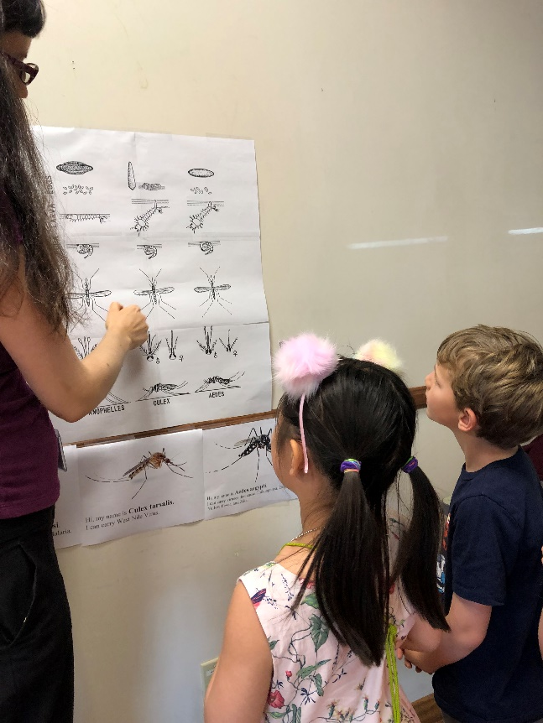
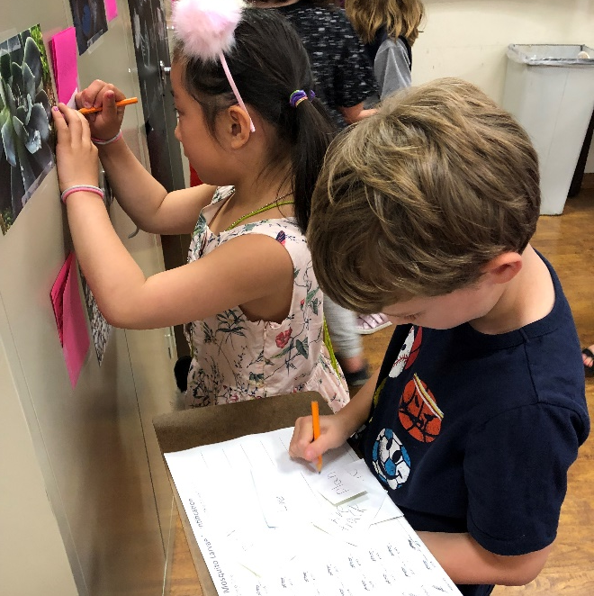
2.0
NeiSci Club @ Branches
Mosquito Habitat Mapper with GLOBE Observer
Notes:
Now I would like to share with you our success story of hosting multi-session mosquito habitat mapper program when I field tested the mosquito habitat mapper kit this past September.

Slide 30
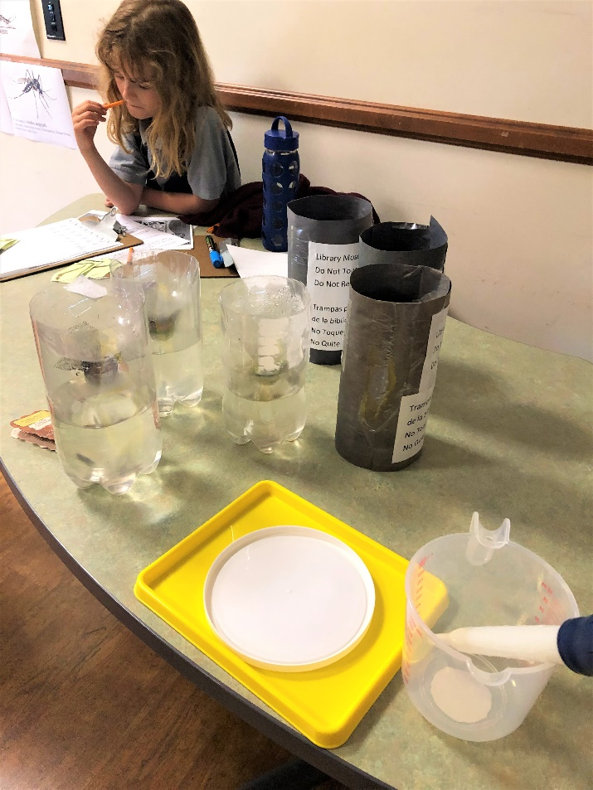
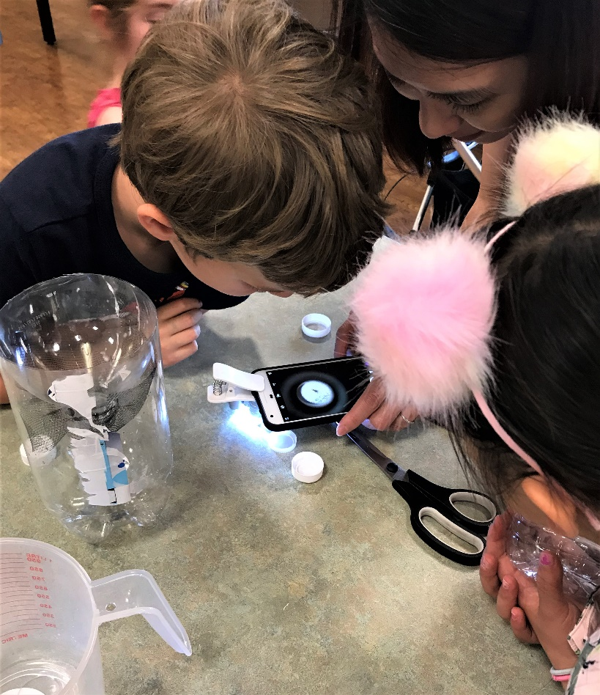
2.0
NeiSci Club @ Branches
Mosquito Habitat Mapper with GLOBE Observer

Slide 31
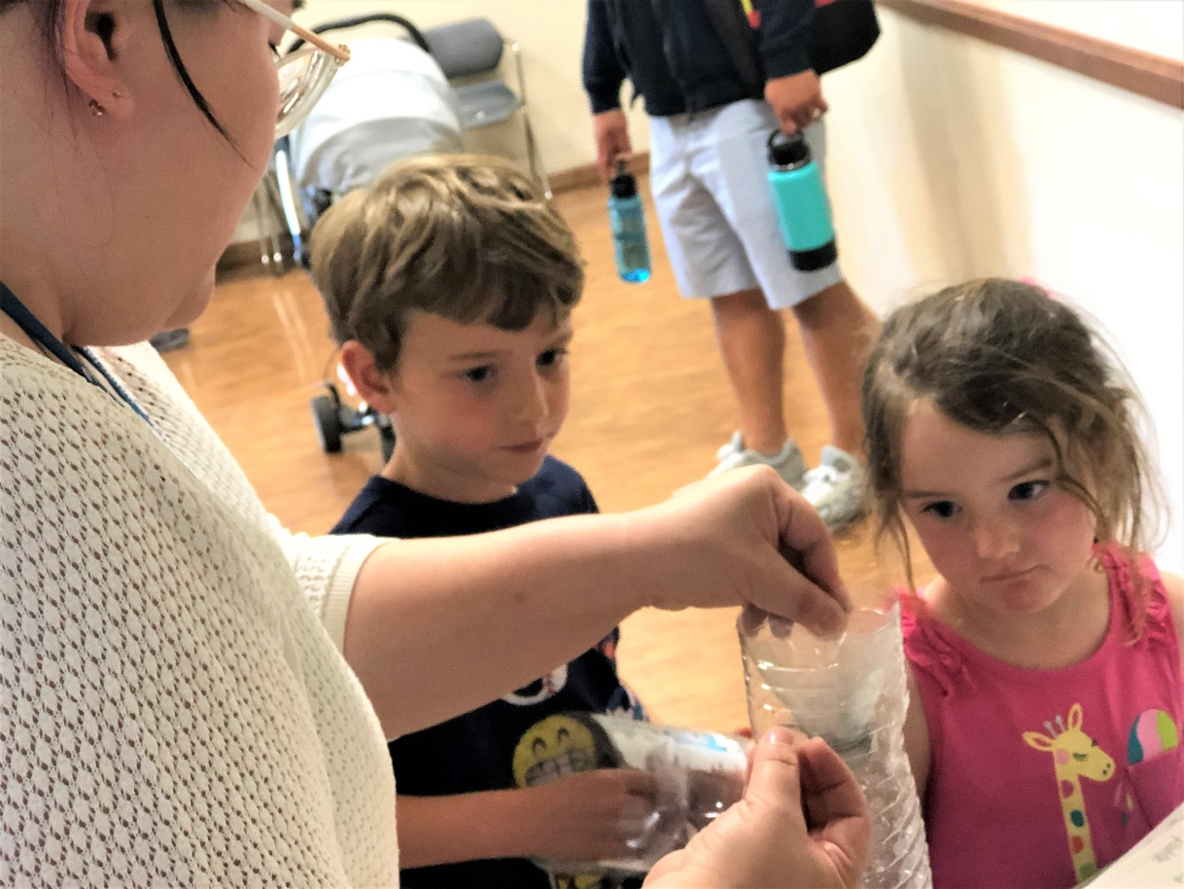
2.0
Nei Sci Club @ Pilot Branches –
Mosquito Habitat Mapper

Slide 32
2.0
Nei Sci Club @ Pilot Branches –
Mosquito Habitat Mapper

Slide 33
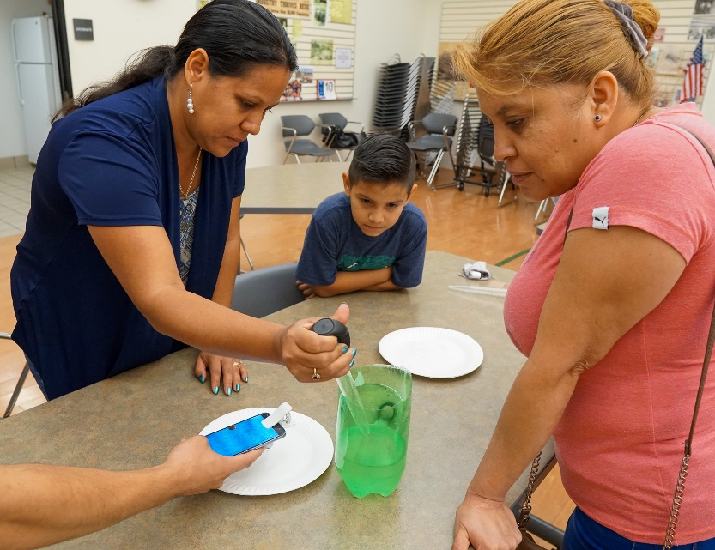
2.0
Nei Sci Club @ Pilot Branches –
Mosquito Habitat Mapper

Slide 34
2.0
Gamified Your Citizen/Neighborhood Science program (Perfect for Teen Council or Teen Programs)
Eyes on Alz Stall Catcher (https://stallcatchers.com)
Play for the Planet (http://playing4theplanet.org/ )
EarthGames (Earthgames.org)
The Climate Trail (https://www.theclimatetrail.com/#about-intro)
Walden, a Game ($$ on xBox, PS4)
Notes:
For Global Citizen Science Month 2020, we have a few ideas, include hosting a prototyping hackathon and citizen science programs using the kits we created. We are also thinking about offering weekly Citizen Science program using connected- or gamified-learning approach, especially if you are interested in engaging teens.
We have branches already planning to offer NeiSci Game-a-thon or tournament for Global Cit Sci Month 2020. This is a great way to segue into authentic citizen science projects once they understand the extent of many pressing environmental or health issues through the games they played.

Slide 35
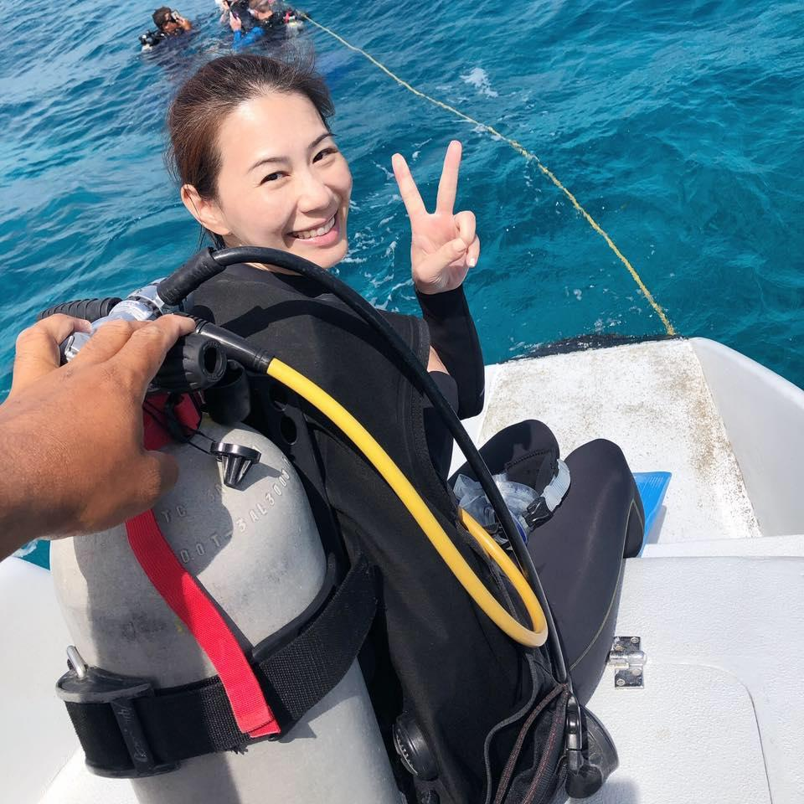
2.0
Vivienne Byrd
Librarian III/STEAM Librarian
Exploration & Creativity Department
Los Angeles Public Library
vbyrd@lapl.org
213.228.7552
Notes:
Here is my contact information. Please feel free to reach to me if you have any questions about the Neighborhood Science program or about our kits.

Slide 36
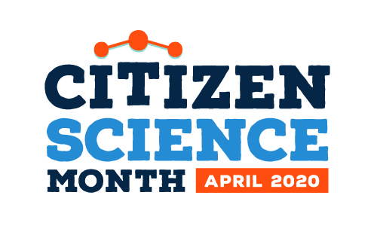
Introducing Citizen Science Month
Notes:
Caroline?

Slide 37
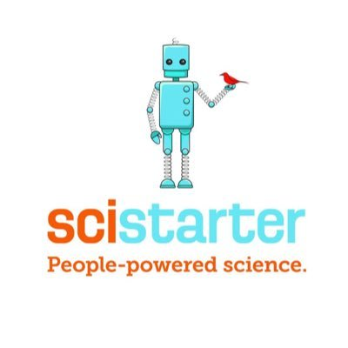
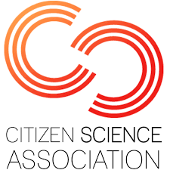
Partners

Slide 38
Institutions
Community
groups
Creating resources
for:
to celebrate
citizen
science.
Individuals
Libraries

Slide 39
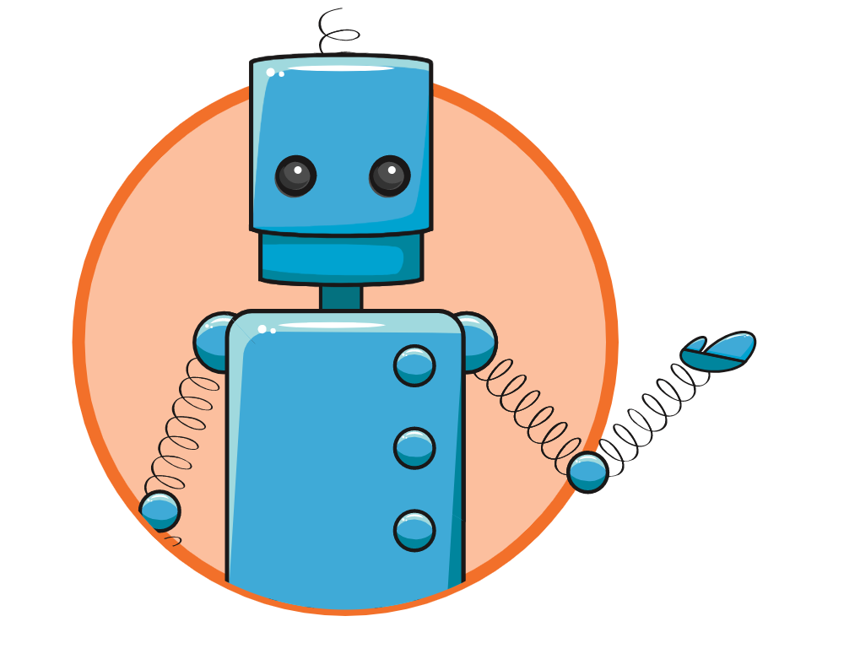
Sign up for Citizen Science Month Updates at SciStarter.org/CitizenScienceMonthFAQ
Join one of the optional weekly “Citizen Science Month Office Hours” calls on Thursdays. Anywhere you are in the world, one of the call times should work for you! More info at SciStarter.org/CitizenScienceMonthFAQ.
Add an event at SciStarter.org/CitizenScienceMonth. Once you add your event, use the People Finder (SciStarter.org/People-Finder) to message SciStarter users in your area.
We need you!

Slide 40
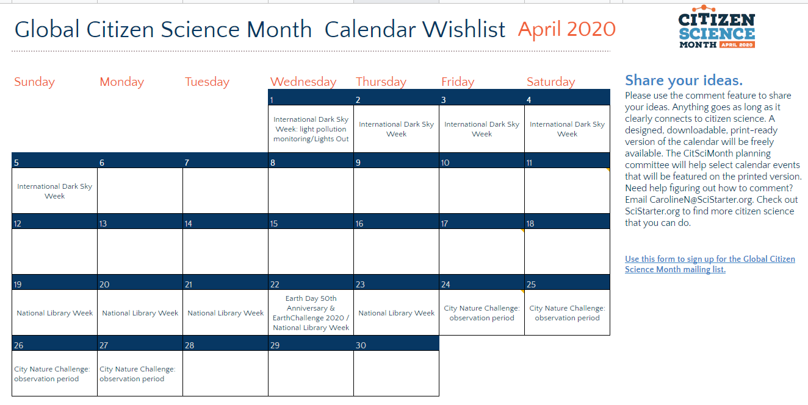
Share your ideas. Make your library a hub for citizen science this April.

Slide 41
Notes:
Caroline

Slide 43
Notes:
Caroline

Slide 44
What projects will you feature in your library?
Find “SciStarter Affiliates” using SciStarter.org/Finder.
Track contributions & earn credit for more than 100 SciStarter Affiliate projects.

Slide 45
SciStarter Affiliates

Slide 46
Follow-up
Contact Caroline (CarolineN@SciStarter.org):
to learn more about citizen science
to share ideas
anything else!

