Slide 1
Want to view a recording of this webinar?
View recording here.
Feel free to download these slides and edit them as you see fit for your programs!

Slide 2
@SciStarter
Hello, citizen scientists!
Notes:
2

Slide 3
SciStarter creates opportunities for regular people to do real scientific research.
Notes:
3

Slide 4
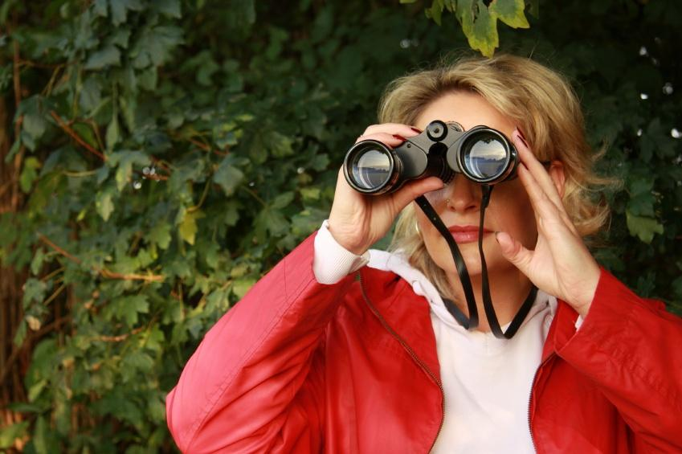
But they can’t find each other.
Notes:
4

Slide 5
We
connect
them
We
connect
them.
Scientist image and cit scientist images tk to illustrate “we connect them”
Notes:
5

Slide 6
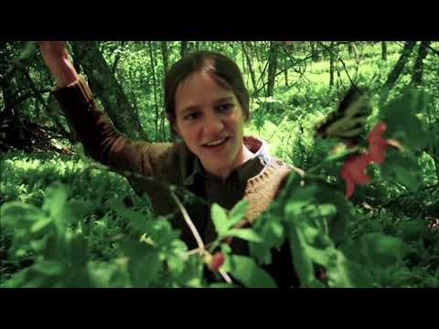

Slide 7
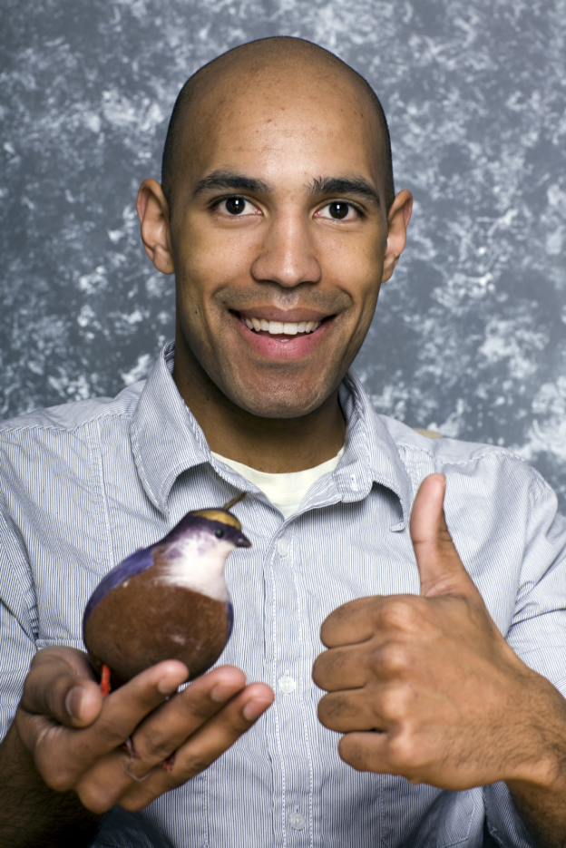
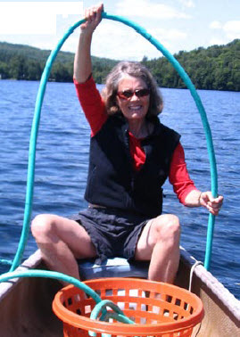
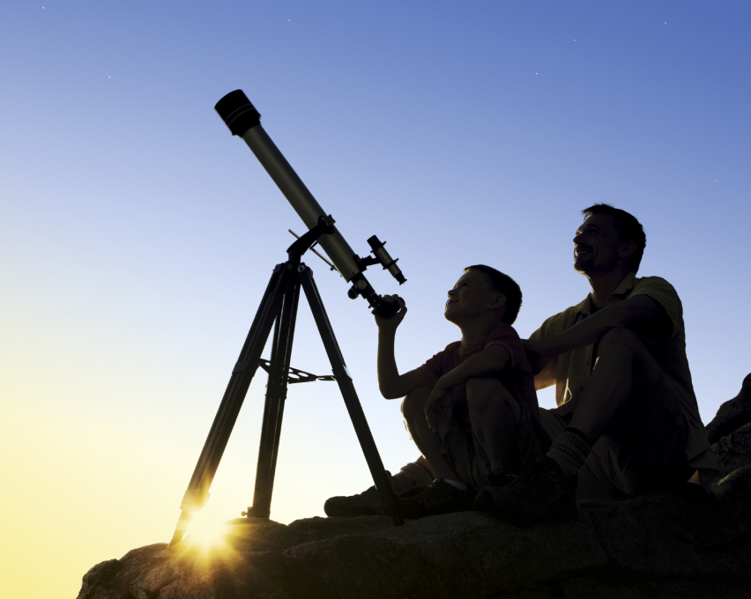
Someone you know is a CITIZEN SCIENTIST
eBird
1.5 million
reports
Water testing
1.5 million
monitors
SETI@home
5 million
volunteers
Notes:
Citizen science enables people from all walks of life to participate in formal and informal scientific research. Millions of people help scientists monitor our nation’s rivers, streams and lakes, measure air quality in their communities and homes, track the migratory paths of species, ground-truth satellite data, and even accelerate Alzheimer’s research through online games. More than 2,000 projects, organized by universities, federal agencies, and community groups, are searchable on SciStarter.org. With topics ranging from Astronomy to Zoology, there’s something for everyone! Join SciStarter to find, join, and keep track of your contributions to all types of citizen science projects and events.
7

Slide 8
Common features of citizen science:
Anyone can participate;
Participants and professional scientists know the data can be trusted and used; they follow the same process—or protocols--to make observations and collect, share, and analyze data;
Data can help scientists and participants advance research and support decision-making;
The public, as well as scientists, have access to and can use the data.
https://www.nap.edu/catalog/25183/learning-through-citizen-science-enhancing-opportunities-by-design

Slide 9
Because of Citizen Scientists:
Parrish, Julia. University of Washington (2014)
In a study of 338 citizen science projects:
1.3–2.3 million citizen scientists
had an economic value of $2.5 billion per year.

Slide 11
Designing Citizen Science
Learning Through Citizen Science: Enhancing Opportunities by Design (2018), a report from the National Academies of Sciences, Engineering, and Medicine.
When designed well, citizen science projects can enhance learning outcomes for citizen scientists.
“Designing for learning has benefits beyond just participant learning: It can enhance overall project goals, like advancing community priorities and enabling scientific discovery.”

Slide 12
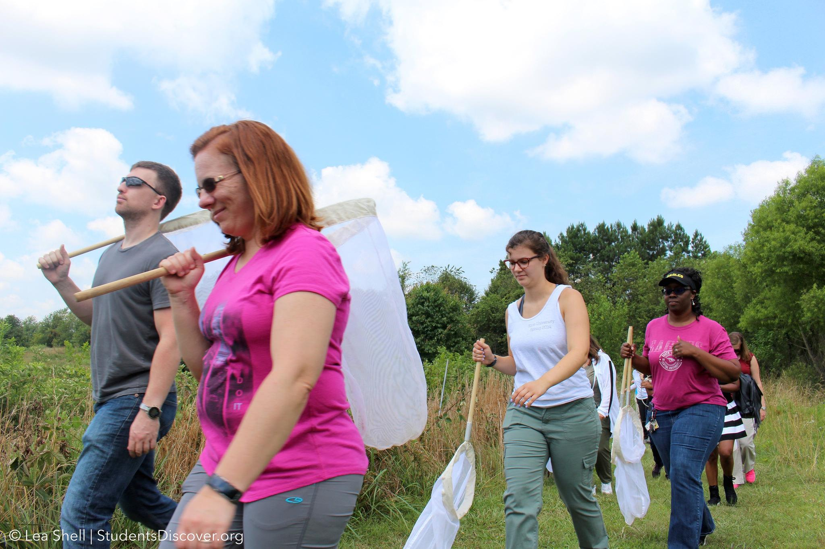
We aim to make research more efficient by connecting communities of citizen scientists AND fields of research.

Slide 13
Components of the SciStarter Process
Evaluation
Tools
Best Practices
Societal,
Economic,
Cultural Context
Privacy
Tools
Visualization
Data
Recruitment, Persistence, Motivations Incentives
Open Datasets
Protocols
and
methodologies

Slide 14
Supporting universal, lifelong learners.

Slide 15
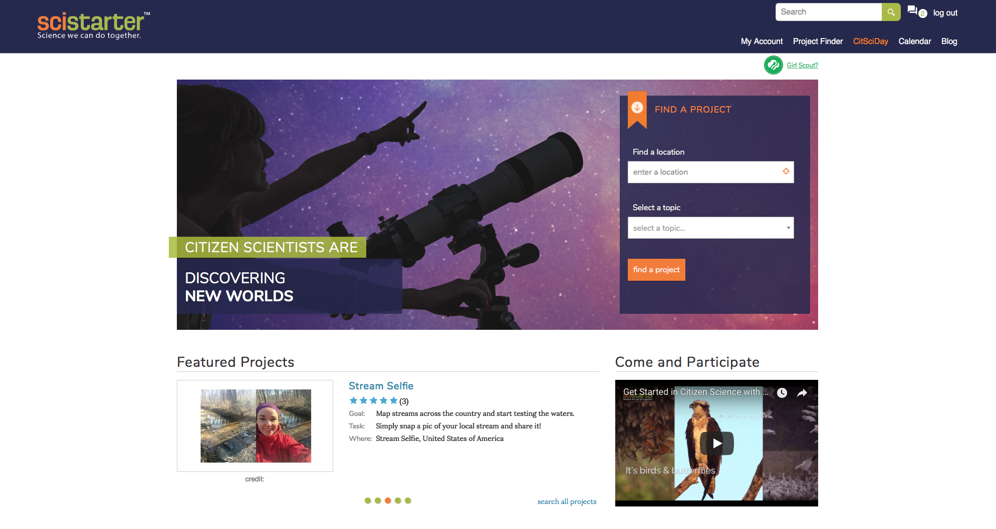
SciStarter is your gateway to more than
3,000 citizen science projects
“SciStarter is the Amazon.com of Citizen Science,” Carl Zimmer, Discover Magazine

Slide 16
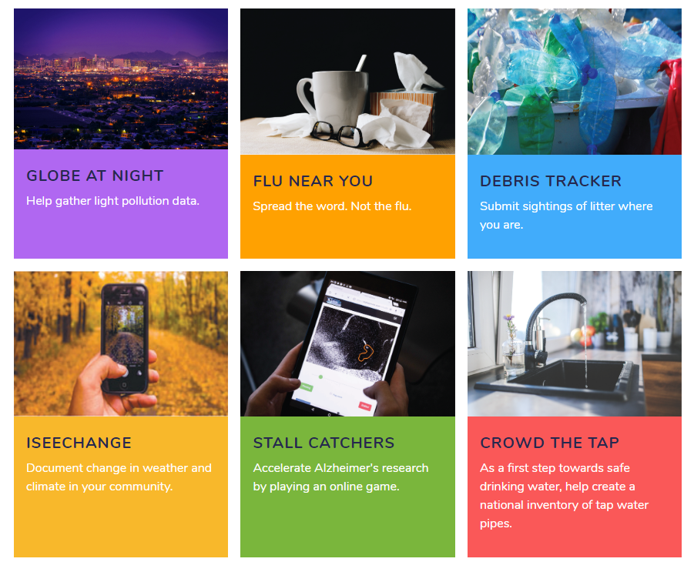
SciStarter.org/NLM

Slide 17
Verizon.SciStarter.org

Slide 18
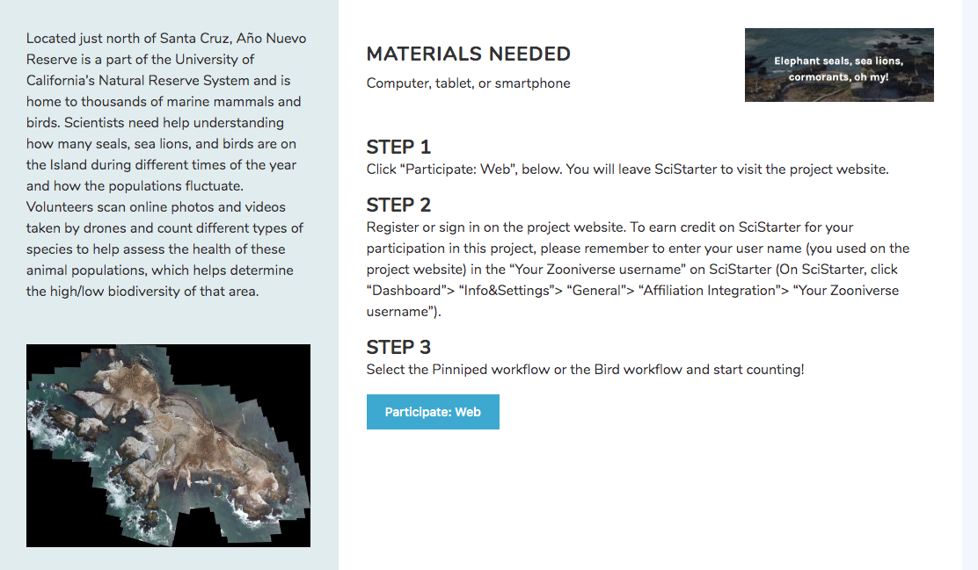
All projects have step by step instructions and a link to a website or app to participate.

Slide 19
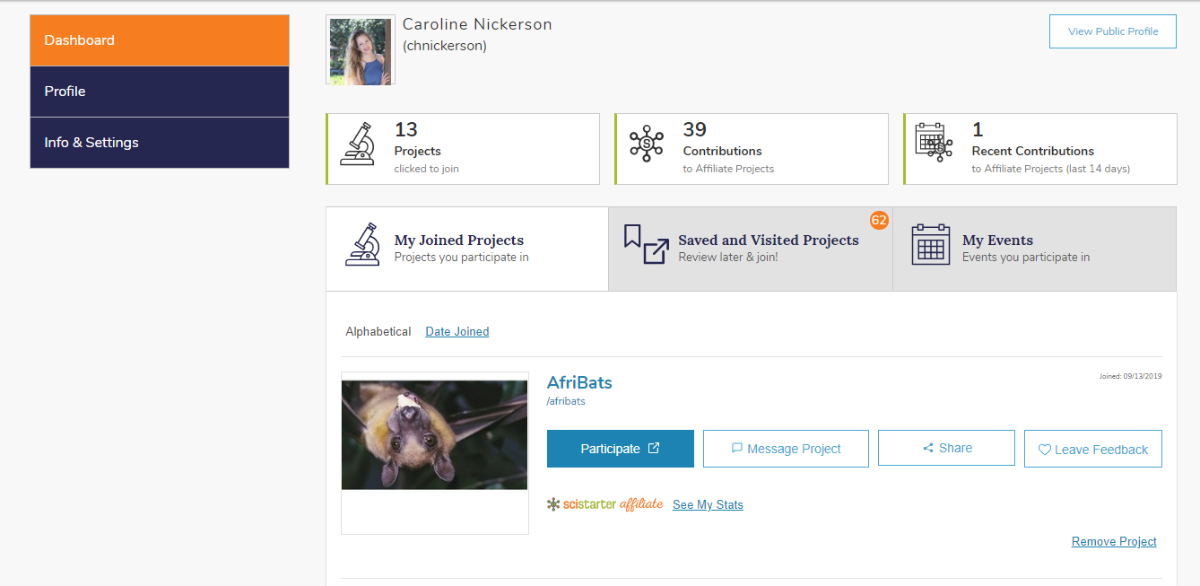
Dashboards
SciStarter: Digital Community Tools
Find recommended projects
Track your contributions across projects
Display your profile and accomplishments

Slide 20
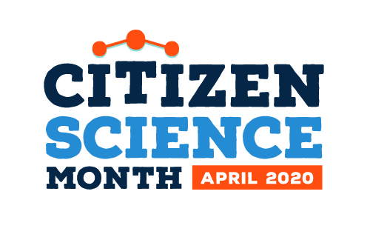
Introducing Citizen Science Month
Notes:
Caroline?

Slide 21
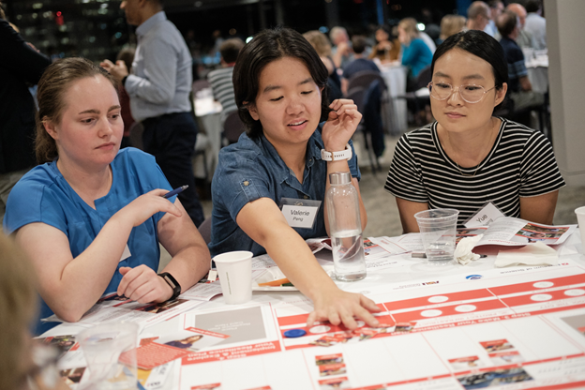
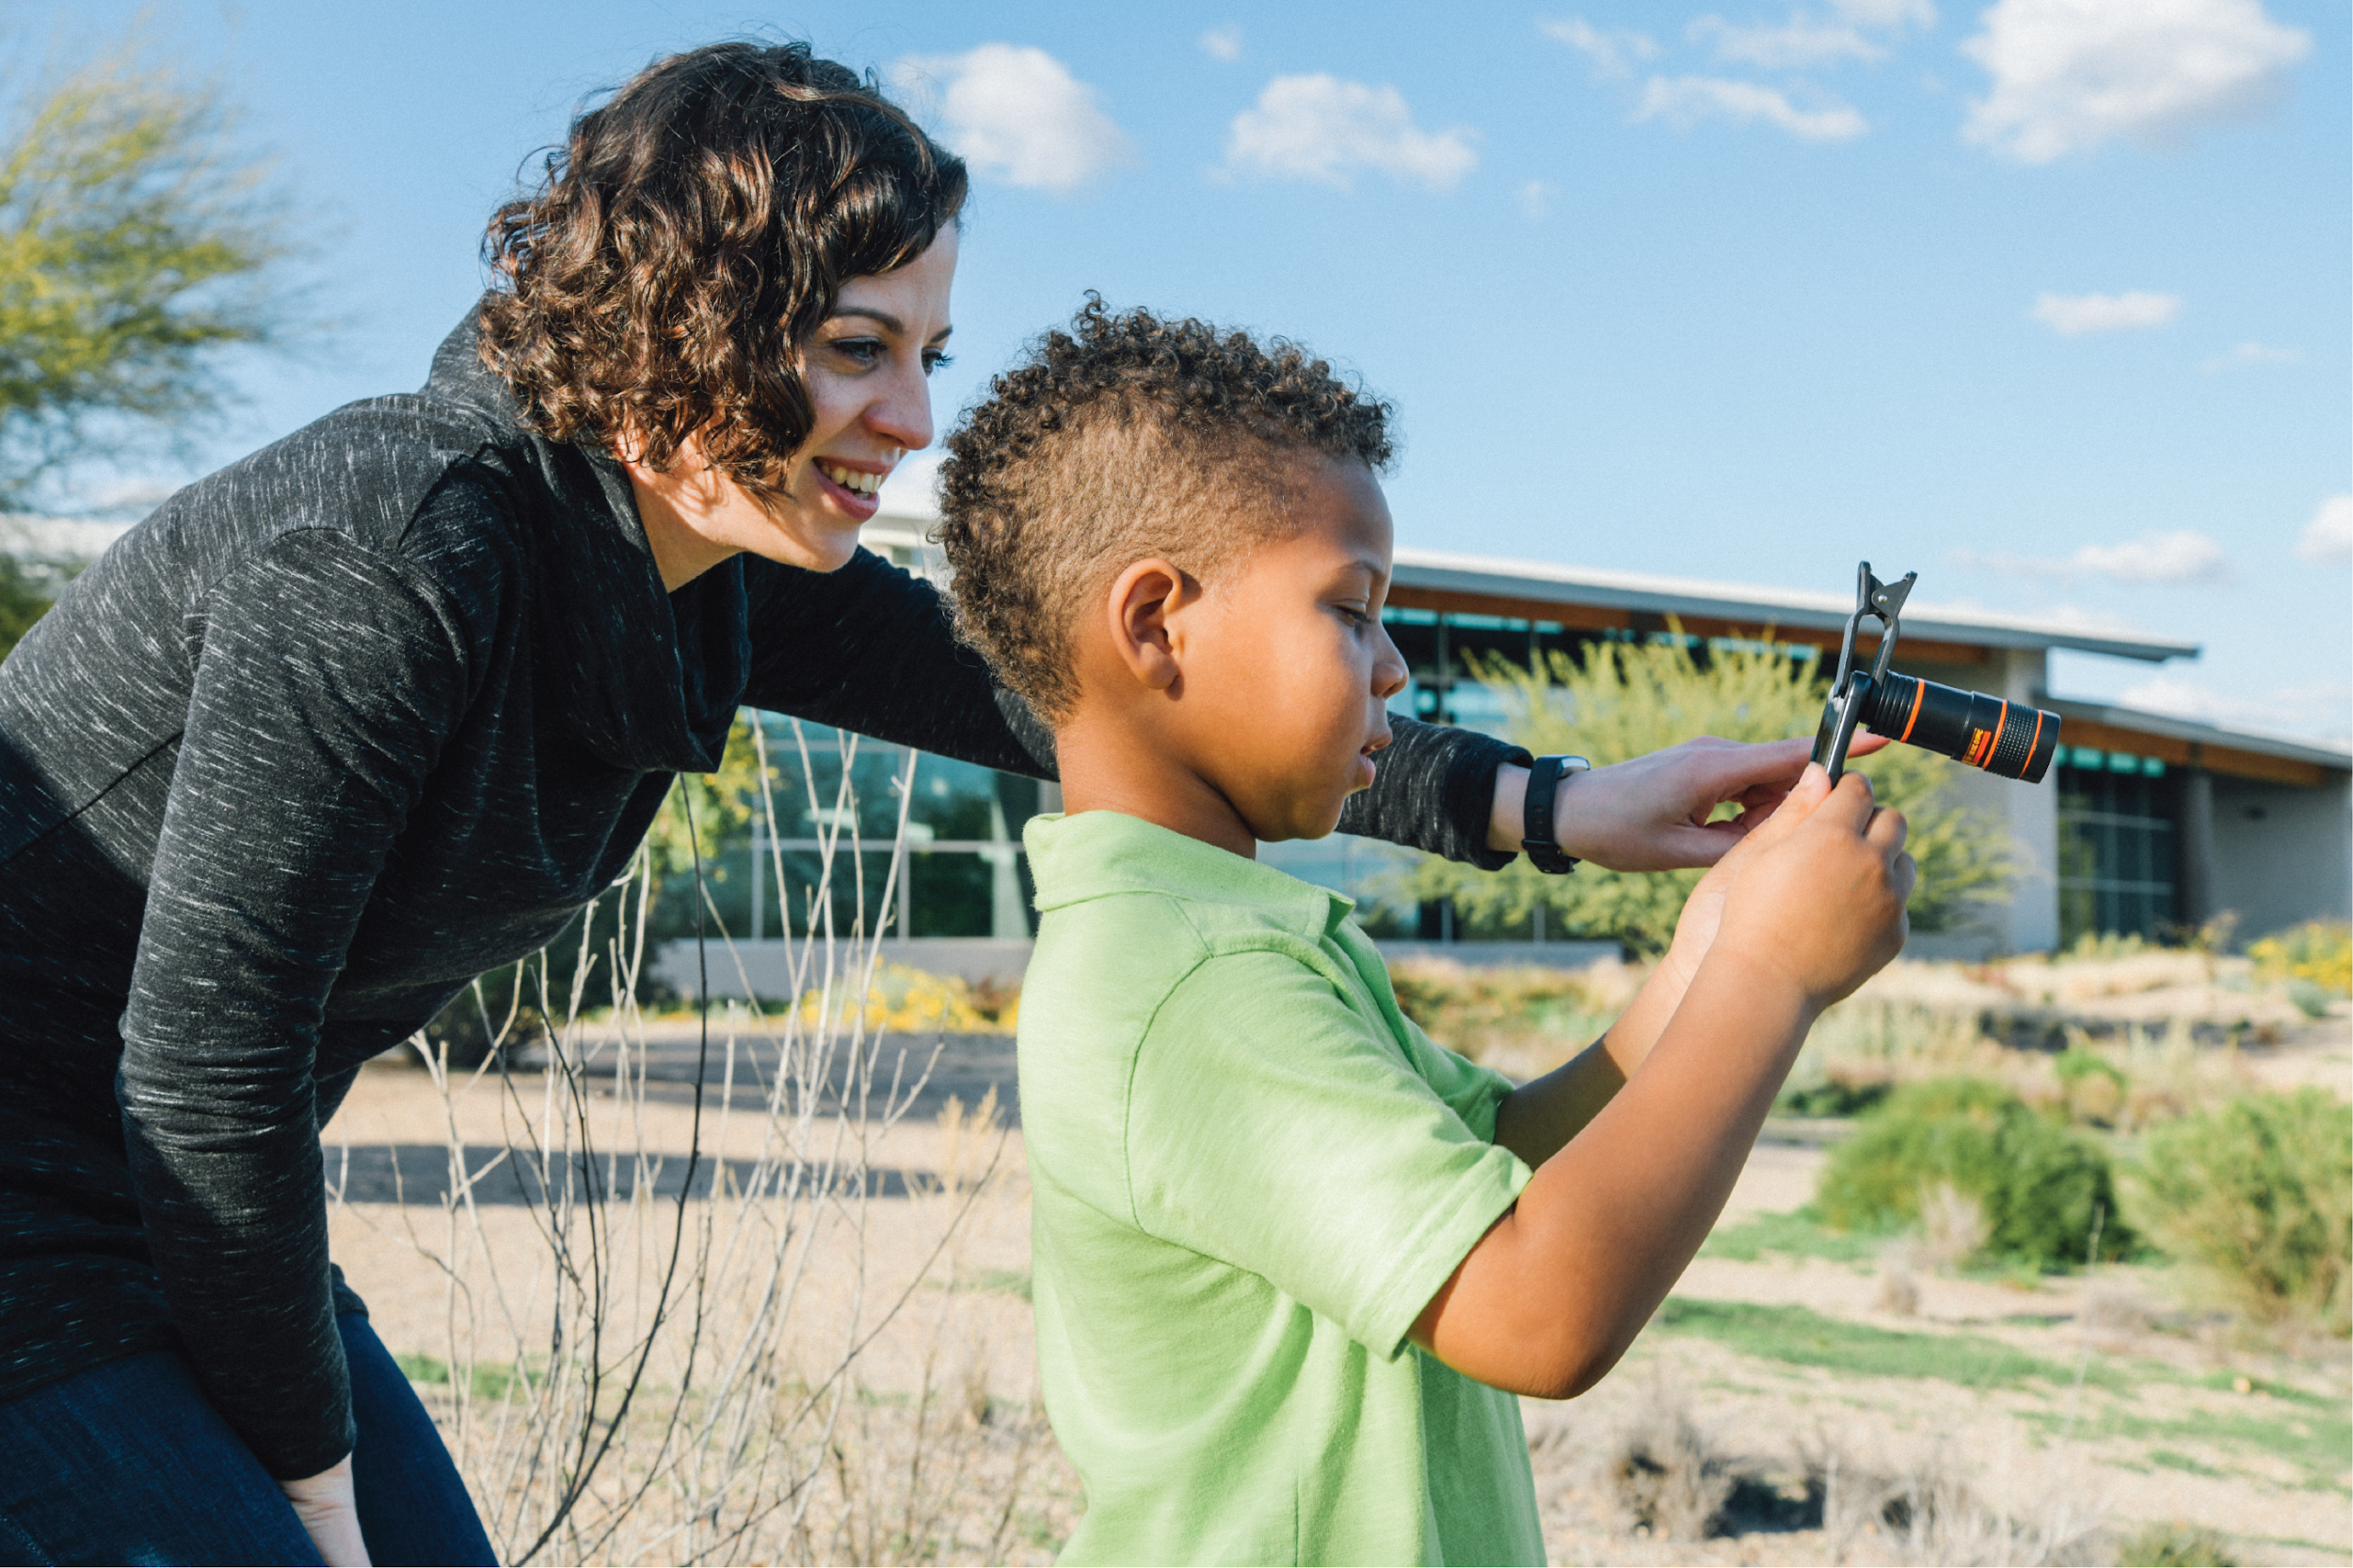
Participate in Live Events.
Meet other citizen scientists and researchers in your area.
Learn about other opportunities to get involved.
Notes:
Second way to volunteer: Citizen Science month

Slide 22
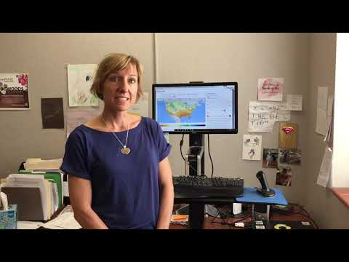
Hear back from the project
about why your work mattered.

Slide 23
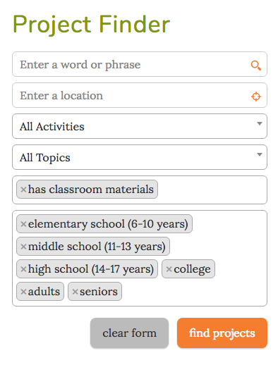
Use the mini Project Finder
on the home page
or the Advanced Search option
to find projects.
Search by:
Activities Location
Indoor/outdoor Interest
Online/offline Age level

Slide 24
What projects will you feature for your event?
Find “SciStarter Affiliates” using SciStarter.org/Finder.
Track contributions & earn credit.

Slide 25
Follow-up
Contact Caroline (CarolineN@SciStarter.org) about:
Learning more about citizen science
Making suggestions about the program
Anything else!

Slide 26
Let’s dive into a module!
SciStarter.org/NLM

